Slide 1
Neuroendocrine Differentiation in Prostatic Adenocarcinoma
Jonathan Epstein

Slide 2
Conflict of Interest
No Relevant Conflict of Interest

Slide 3
Neuroendocrine Differentiation in Prostate Cancer
Almost all usual adenocarcinomas at radical prostatectomy of the prostate will express NE differentiation as evidenced by immunohistochemistry using chromogranin or synaptophysin

Slide 4
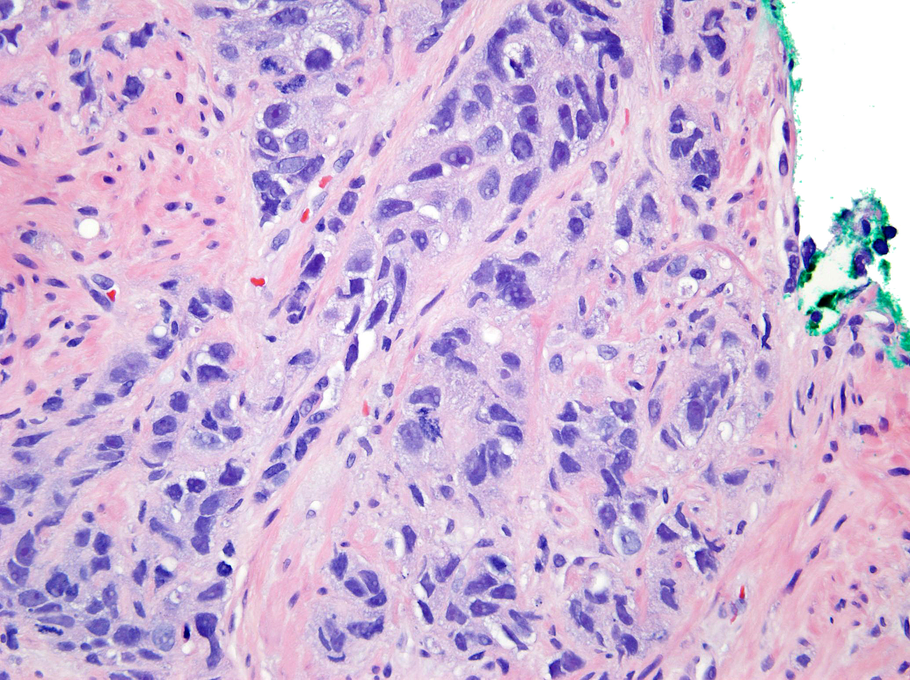

Slide 5
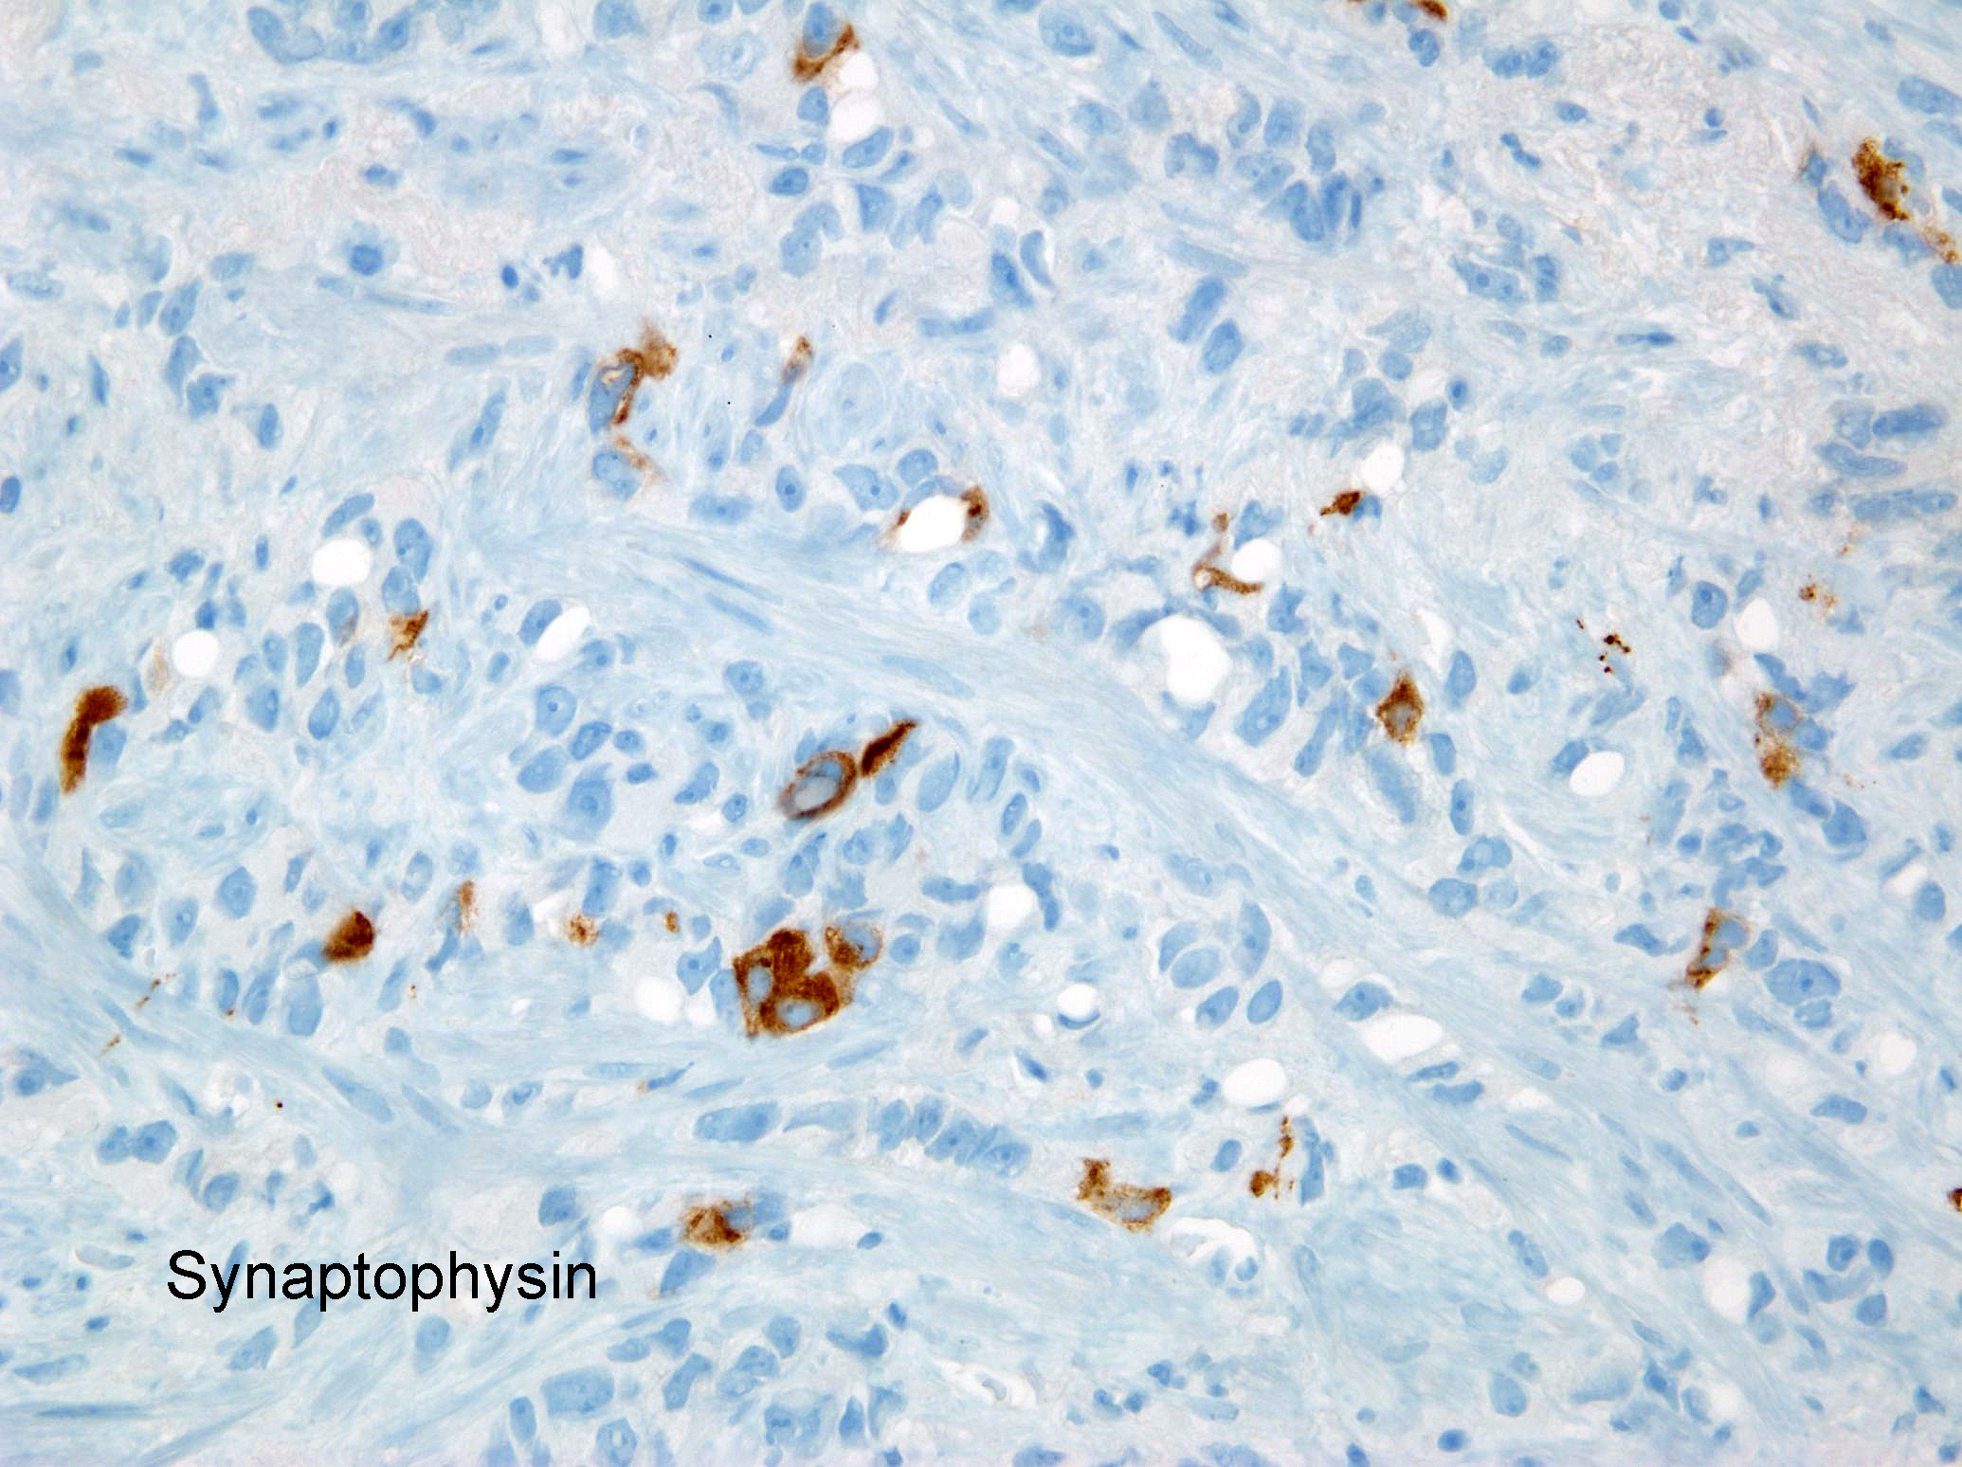

Slide 6
Small Cell Carcinoma

Slide 7
Etiology
Most have de novo clinical presentation of small cell carcinoma of the prostate.
Subset of patients previously diagnosed with prostate adenocarcinoma may develop small cell carcinoma in later stages of castration-resistant prostate cancer (CRPC) progression as a result of treatment resistance.

Slide 8
Small Cell Carcinoma
Advanced stage at diagnosis of small cell cancer >90% stage T3 & T4.
Prior diagnosis of adenocarcinoma (median Gleason score 8) in 14% to 35% of cases - median 18-50 months prior.
At the time of diagnosis of small cell cancer
  Pure small cell cancer in 70%
  Mixed small cell cancer and adenocarcinoma in 30%

Slide 9
? Grade Small Cell Carcinoma
Small cell carcinoma of the prostate has unique histological, immunohistochemical, and clinical features, which differ from those associated with Gleason pattern 5 prostatic acinar carcinoma, such that small cell carcinoma should not be assigned a Gleason grade.

Slide 10
Immunohistochemistry to Differentiate Small Cell Carcinoma from 5+5=10
Prostate markers (NKX3.1, P501S, PSA): Pca (+); SCC (-)
TTF-1: Pca (-): SCC (+in 50%)
RB: Pca (variably retained): SCC (loss)
Ki67: Pca (<50%): SCC: (>80%)
Synaptophysin: Pca (can be patchy): SCC (typically positive)

Slide 11
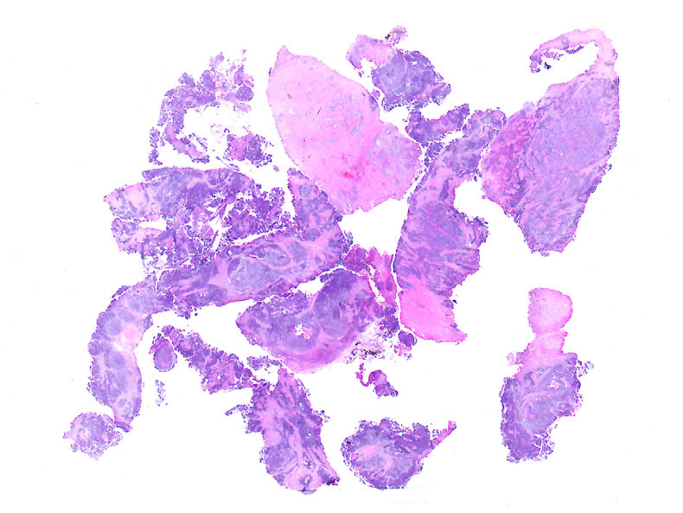

Slide 12
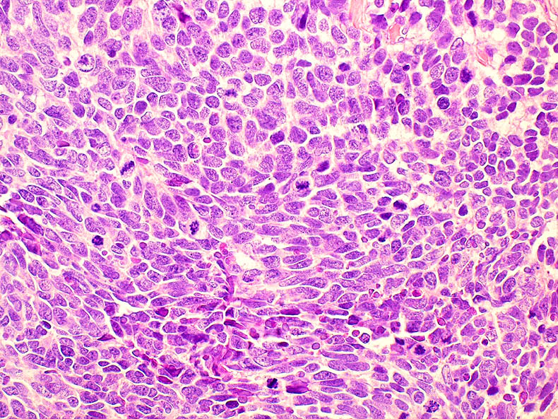

Slide 13
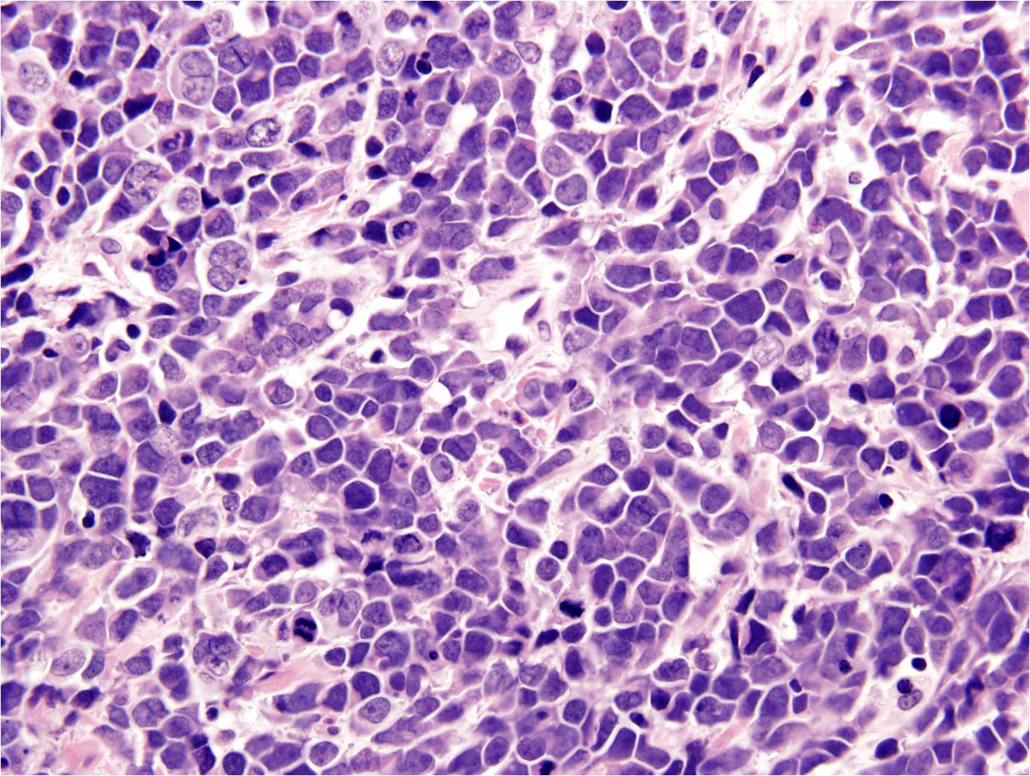

Slide 15
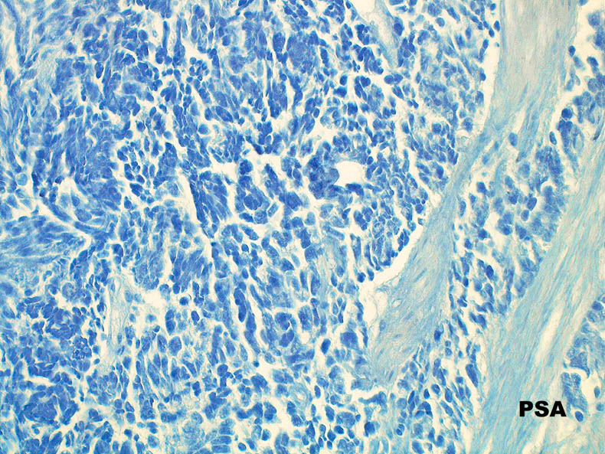

Slide 16
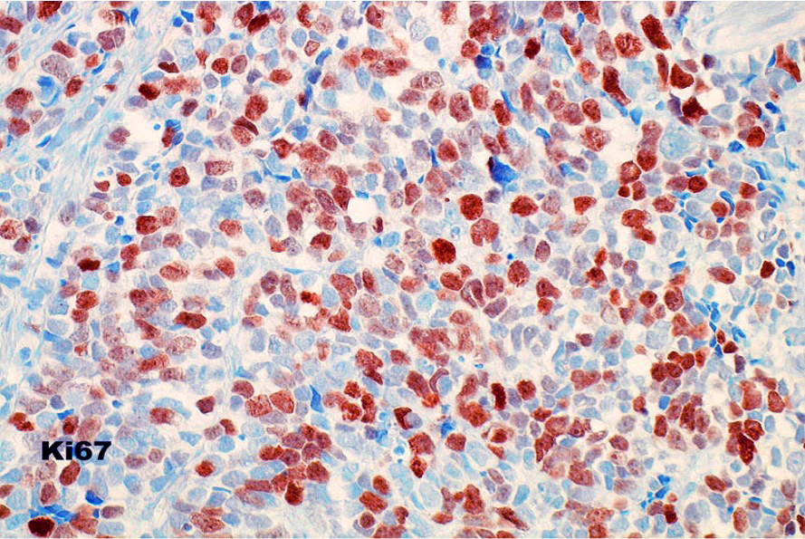

Slide 17
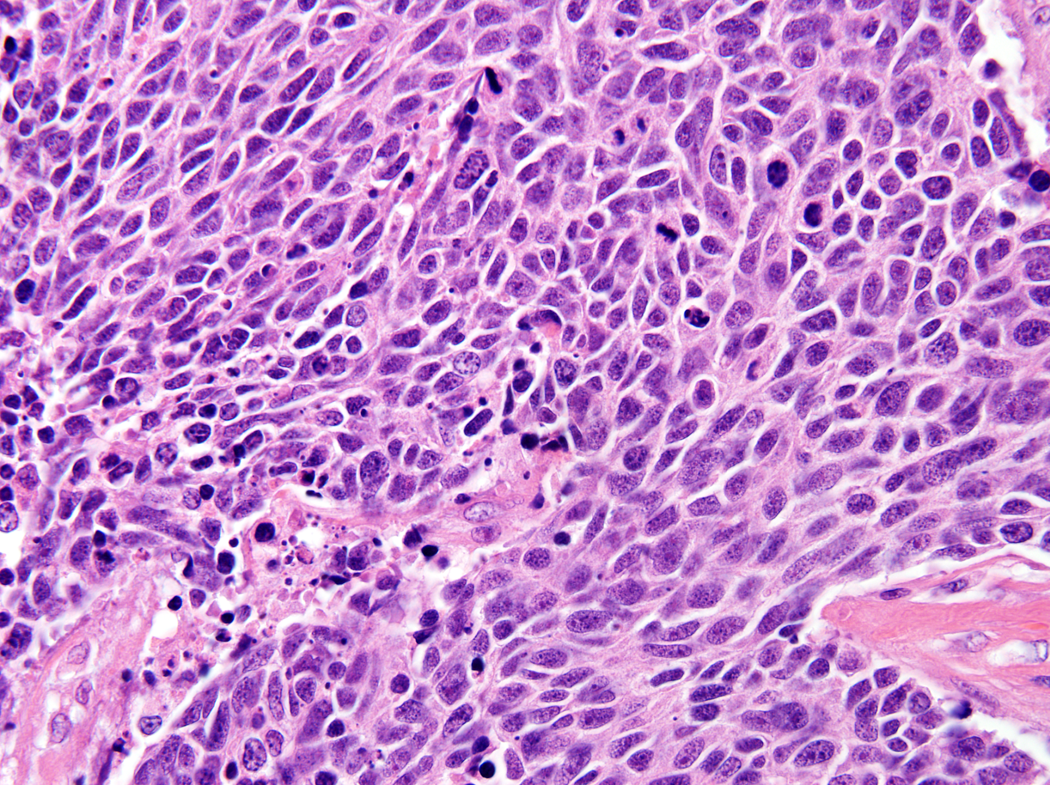
SCC Despite Negative Neuroendocrine Markers

Slide 18
Treatment of Small Cell Carcinoma
Treated with chemotherapy used in small cell carcinoma of the lung.
Not radical prostatectomy, radiation therapy, or hormone therapy.

Slide 19
Prognosis of Small Cell Carcinoma
No difference in prognosis:
  Pure vs. mixed
  Proportion of small cell cancer
  Prior history of adenocarcinoma

Slide 20
Prognosis of Small Cell Carcinoma
  15 year experience of a multi-institutional Canadian study of 41 patients published in 2022
Median survival following diagnosis of small cell cancer of the prostate
  Overall 10 months
  Initially organ-confined 21 months
  Locally advanced 19 months
  Metastatic disease 8 months

Slide 21
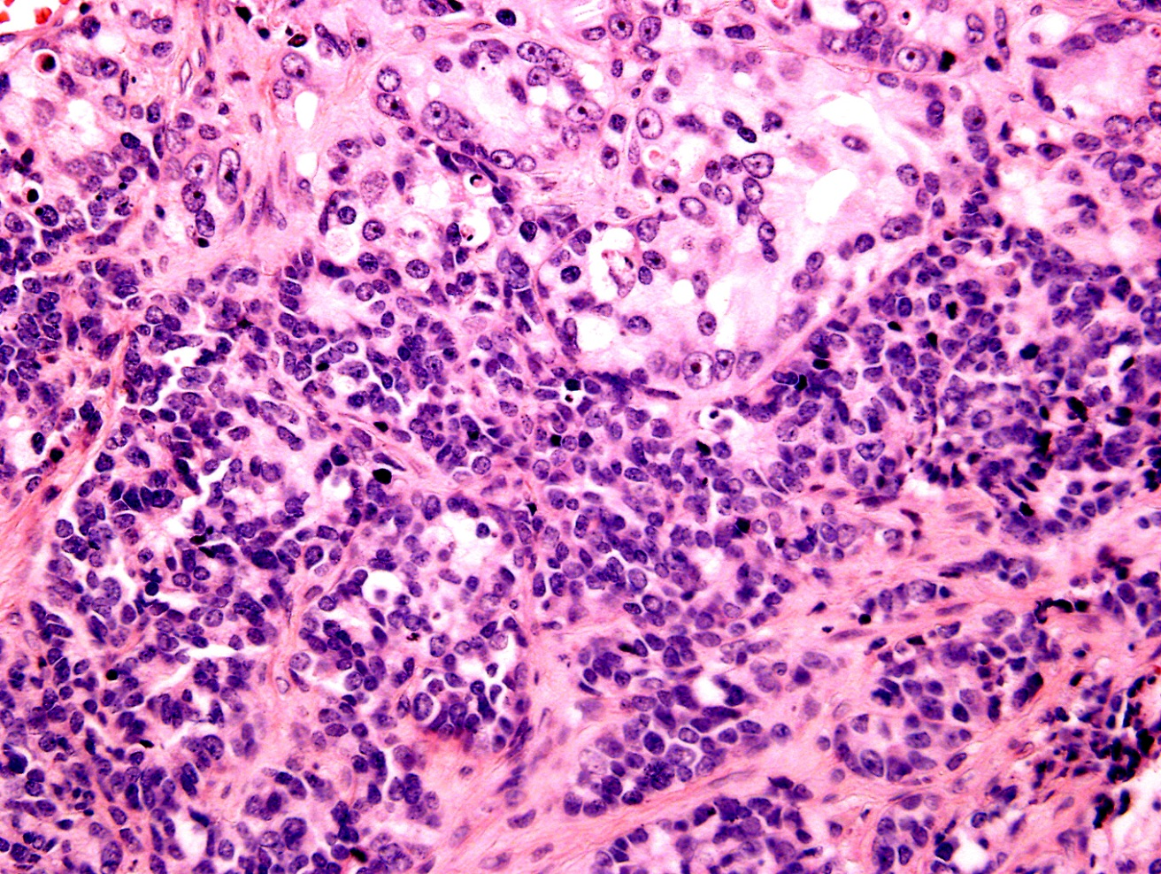
Small Cell Carcinoma & 5+5=10

Slide 22
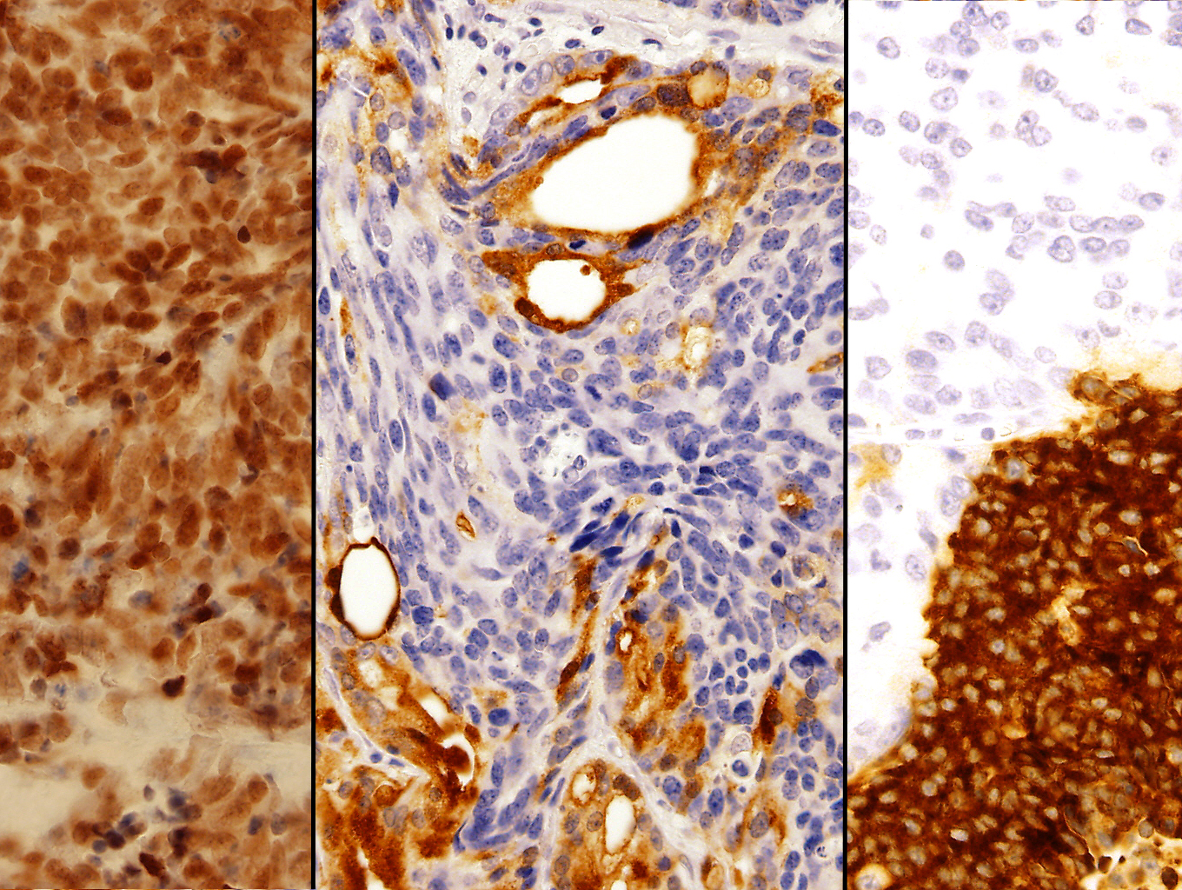
TTF
PSA
SYN

Slide 23
Overlap Cases
Transdifferentiation of Usual Prostate Adenocarcinoma to Small Cell Carcinoma

Slide 24
Overlap Case
IHC looks like Pca but morphology looks between Pca and SCC
Was positive for prostate specific markers

Slide 25
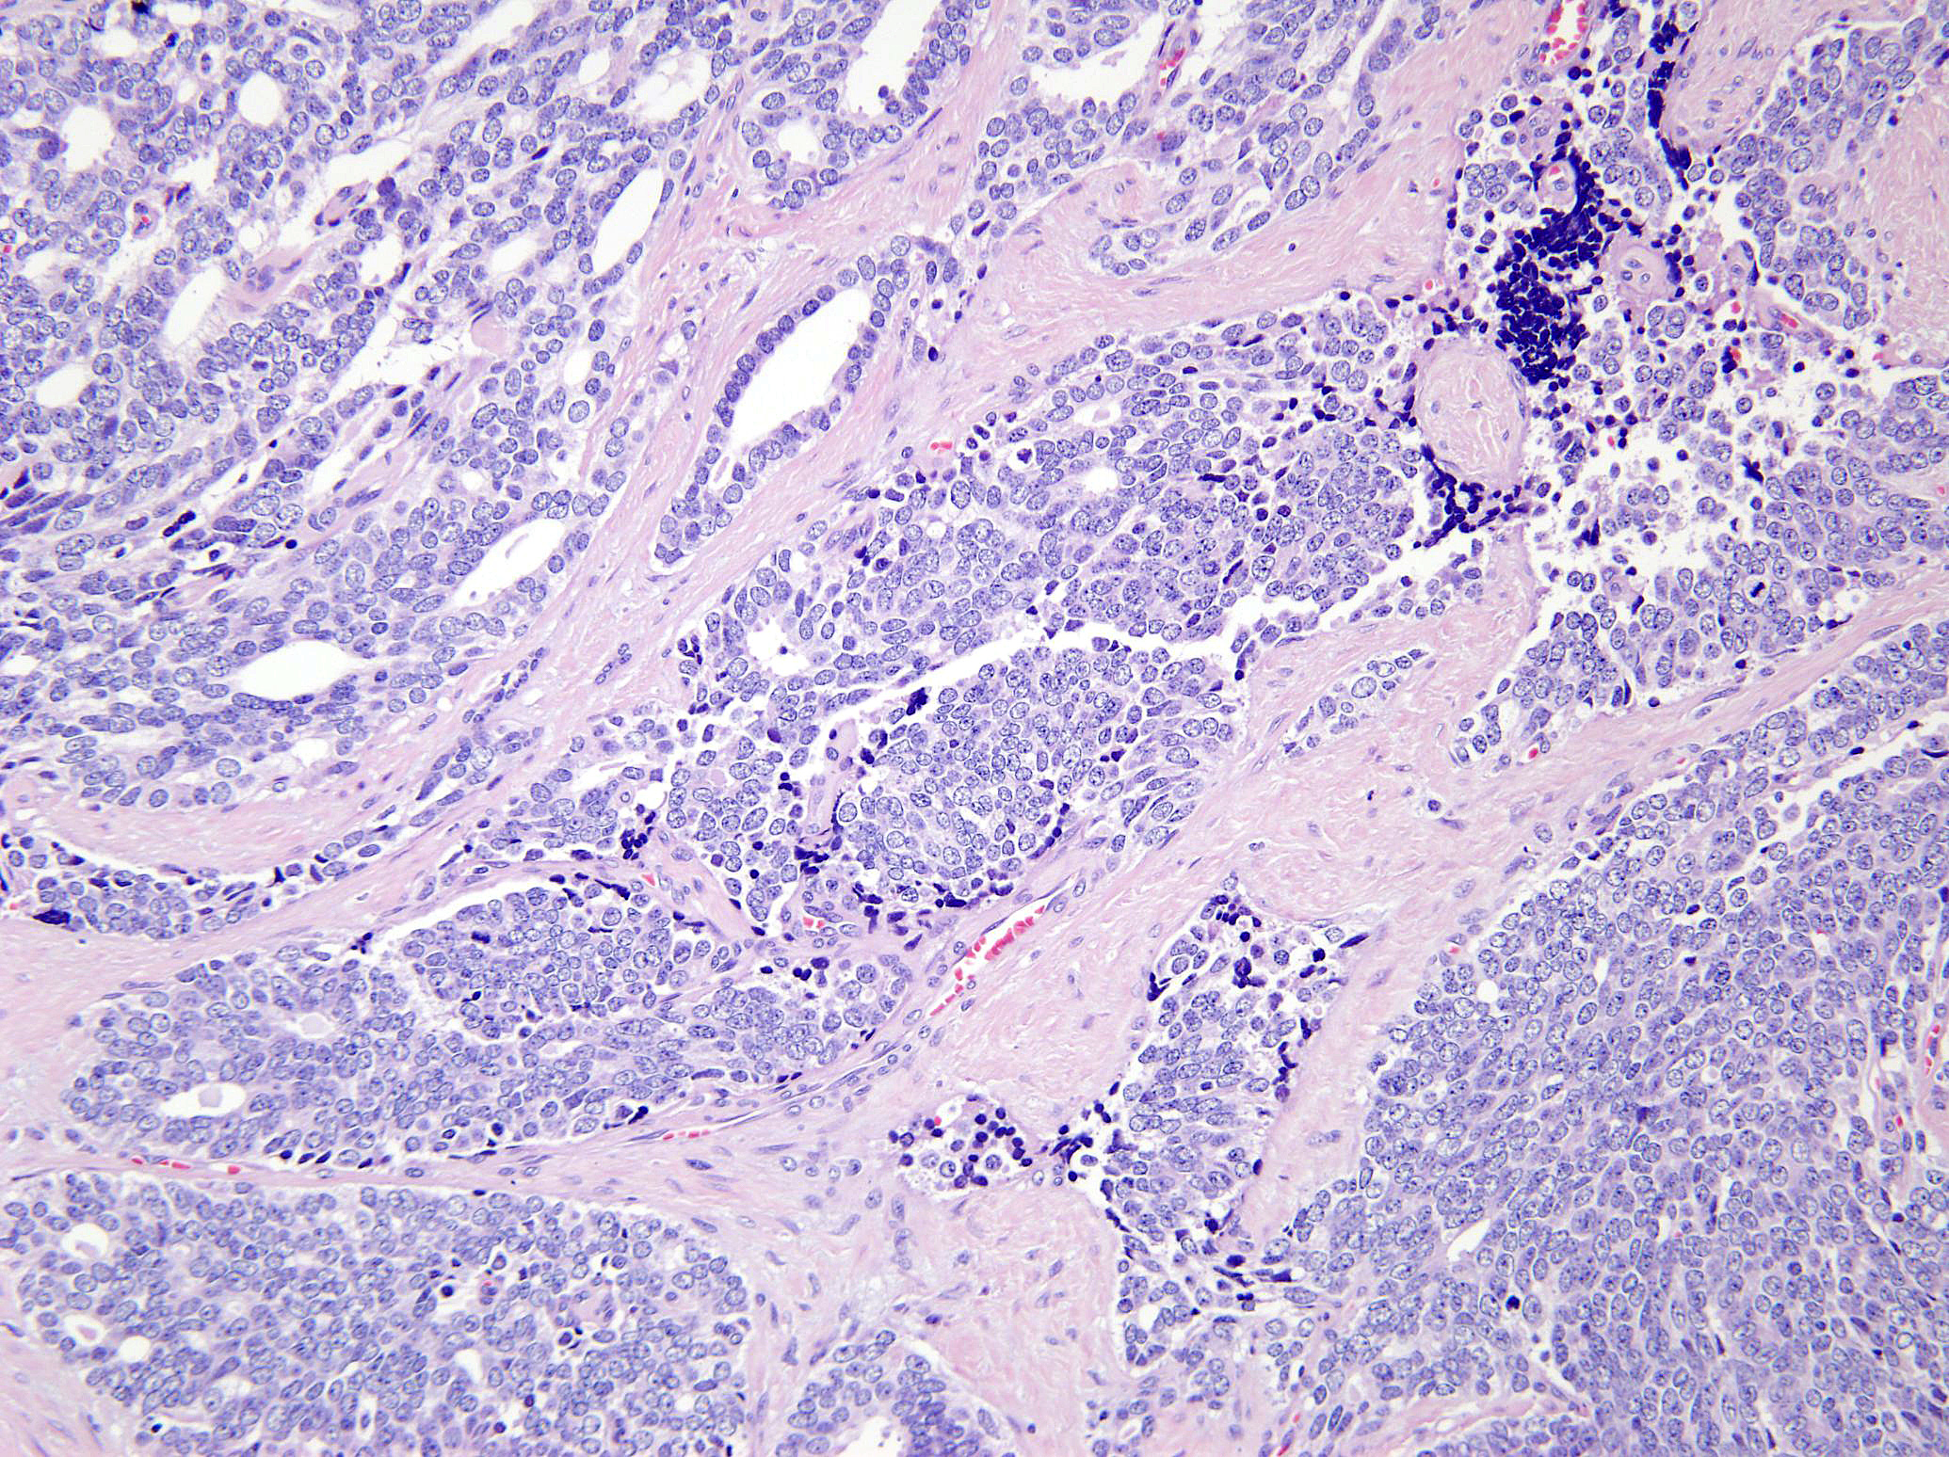

Slide 26
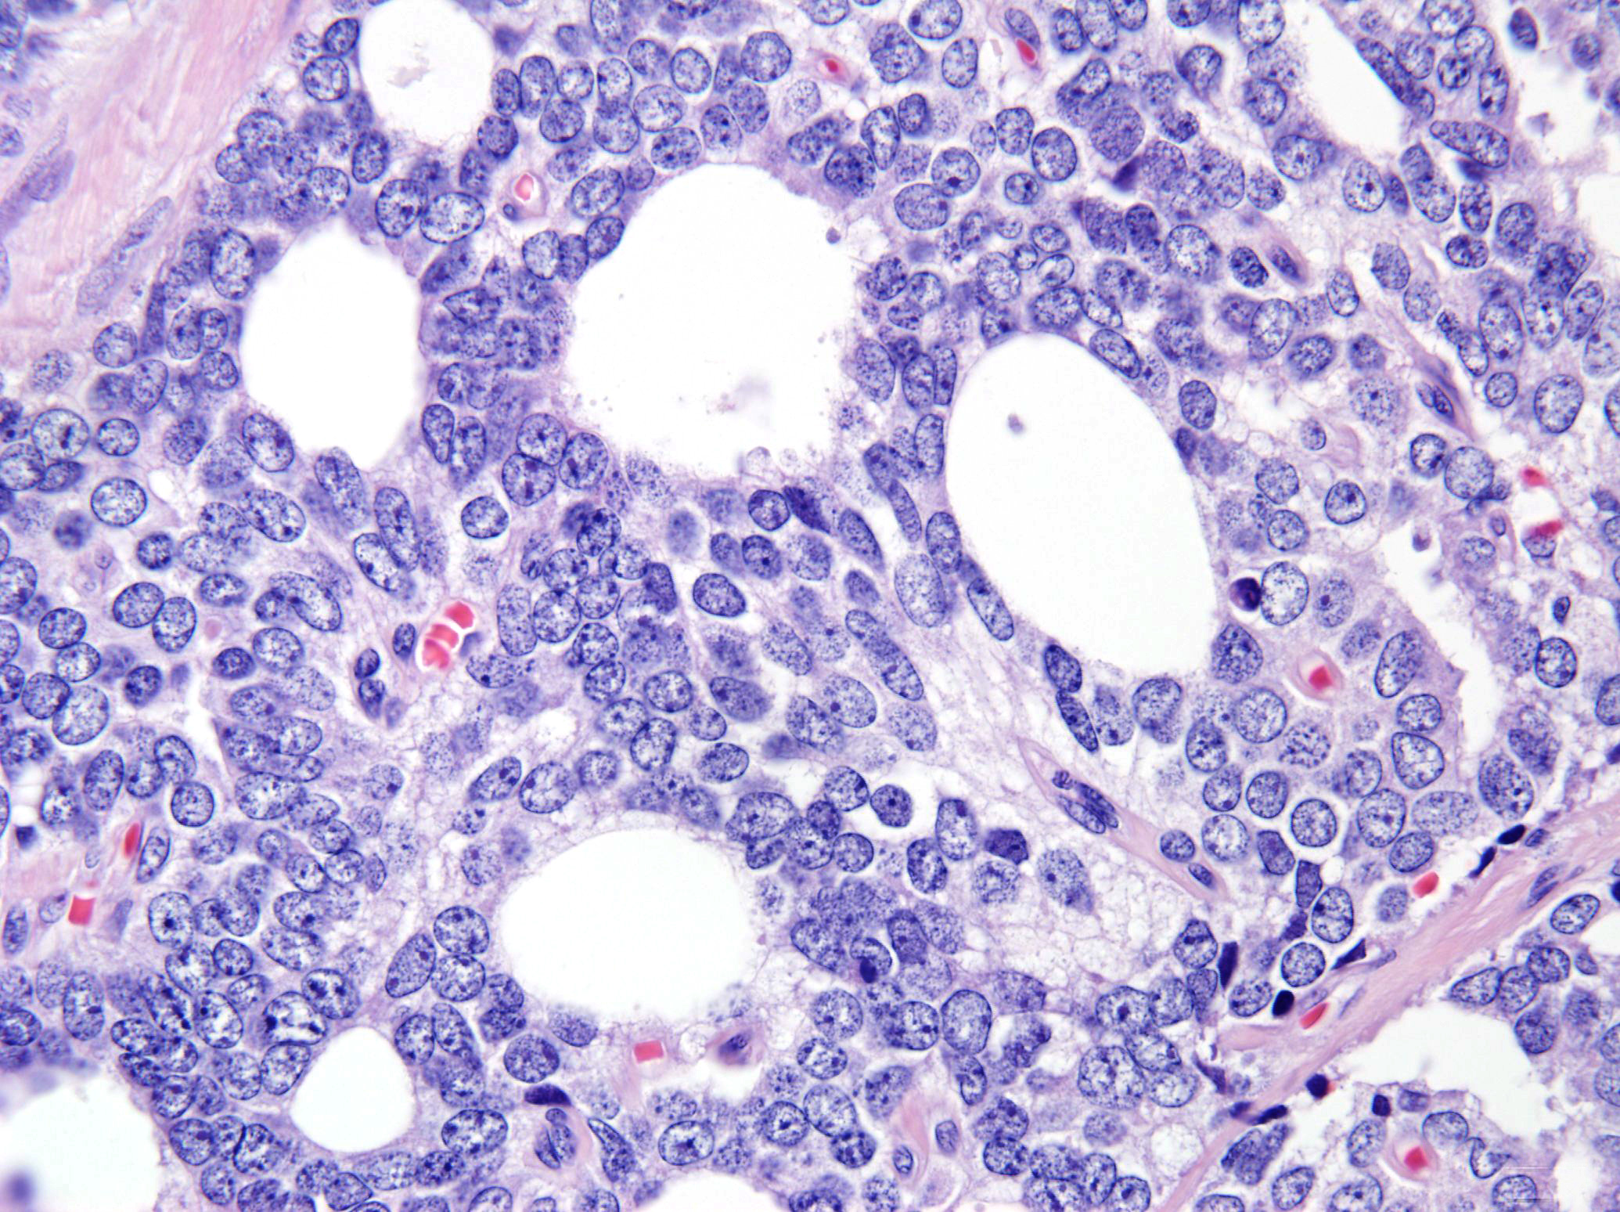

Slide 27
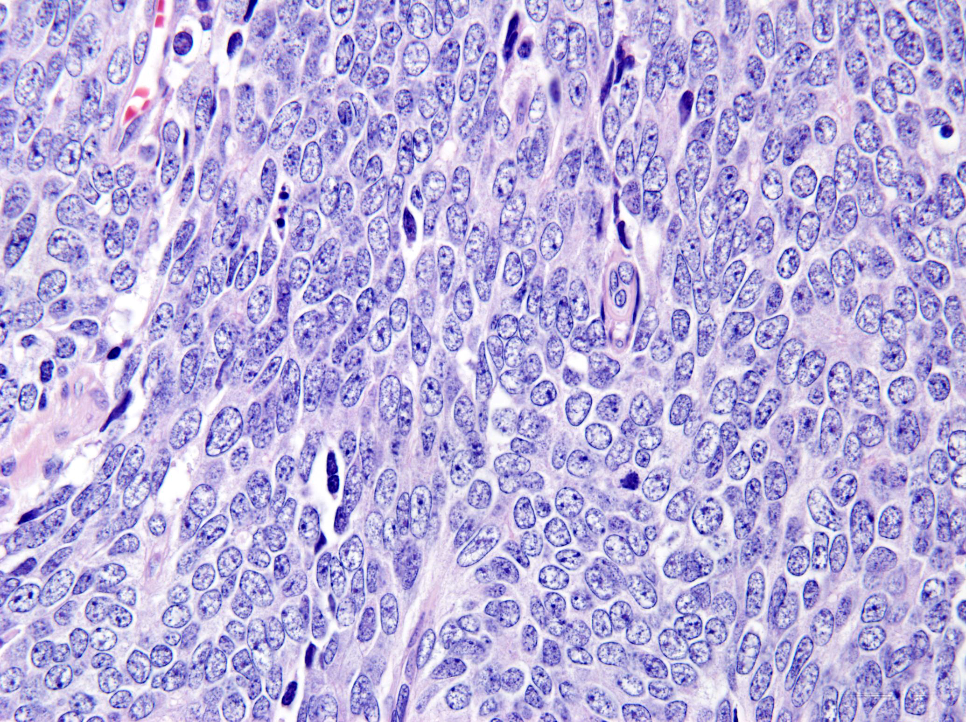

Slide 28
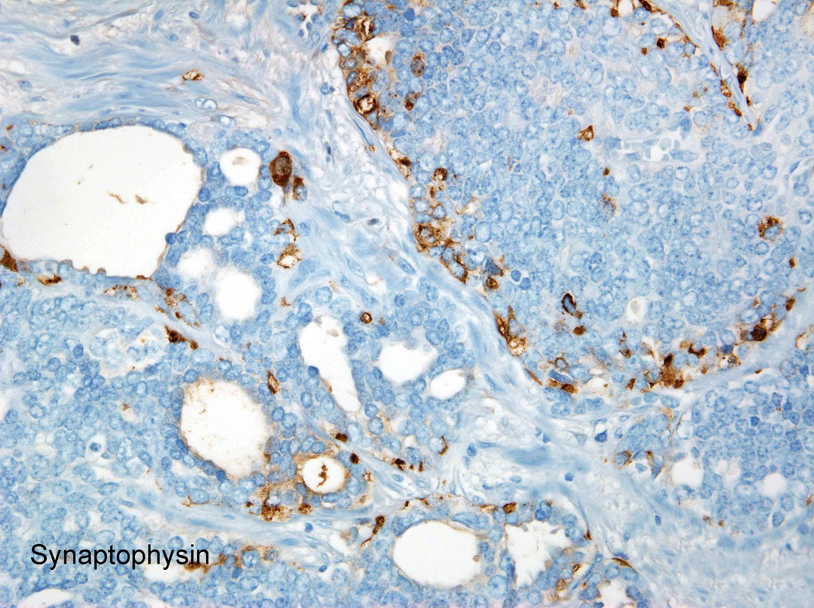

Slide 29
? Small Cell Carcinoma
Morphology – Small cell carcinoma
Synaptophysin +
Chromogranin +
PSA+

Slide 30
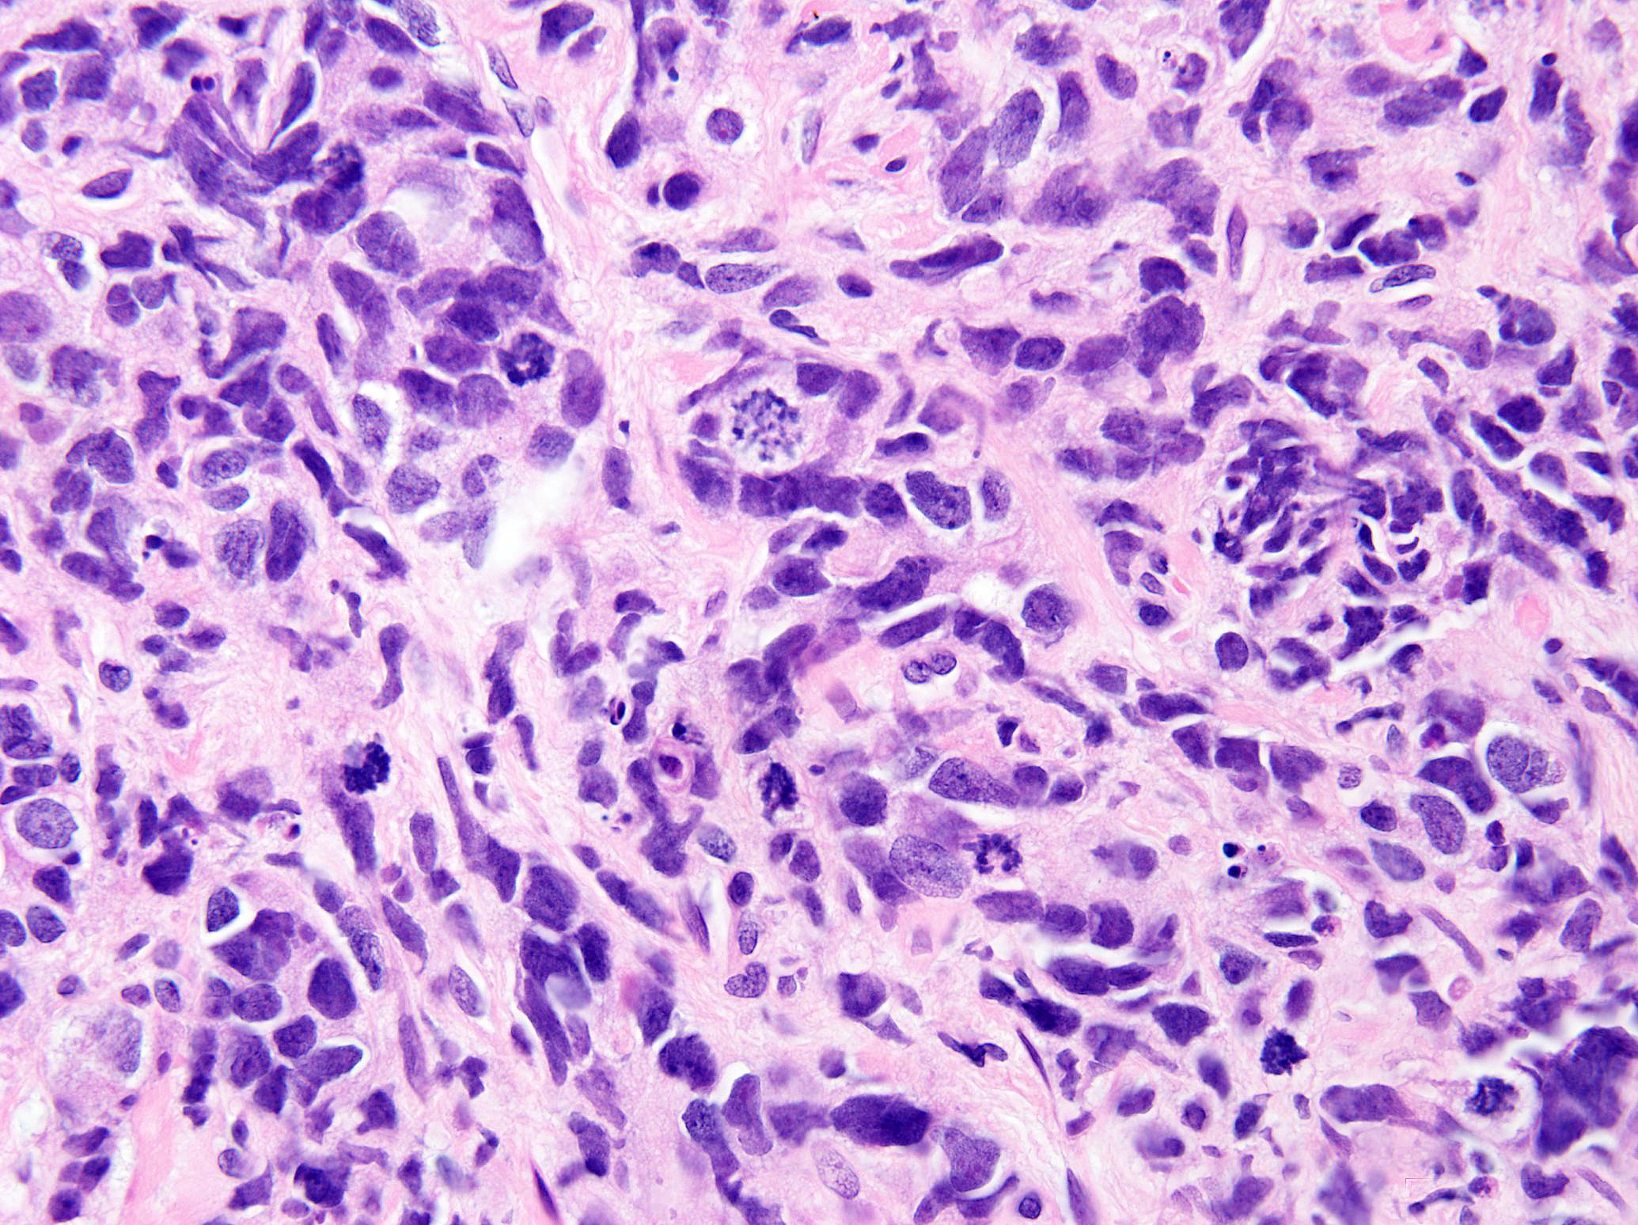

Slide 31
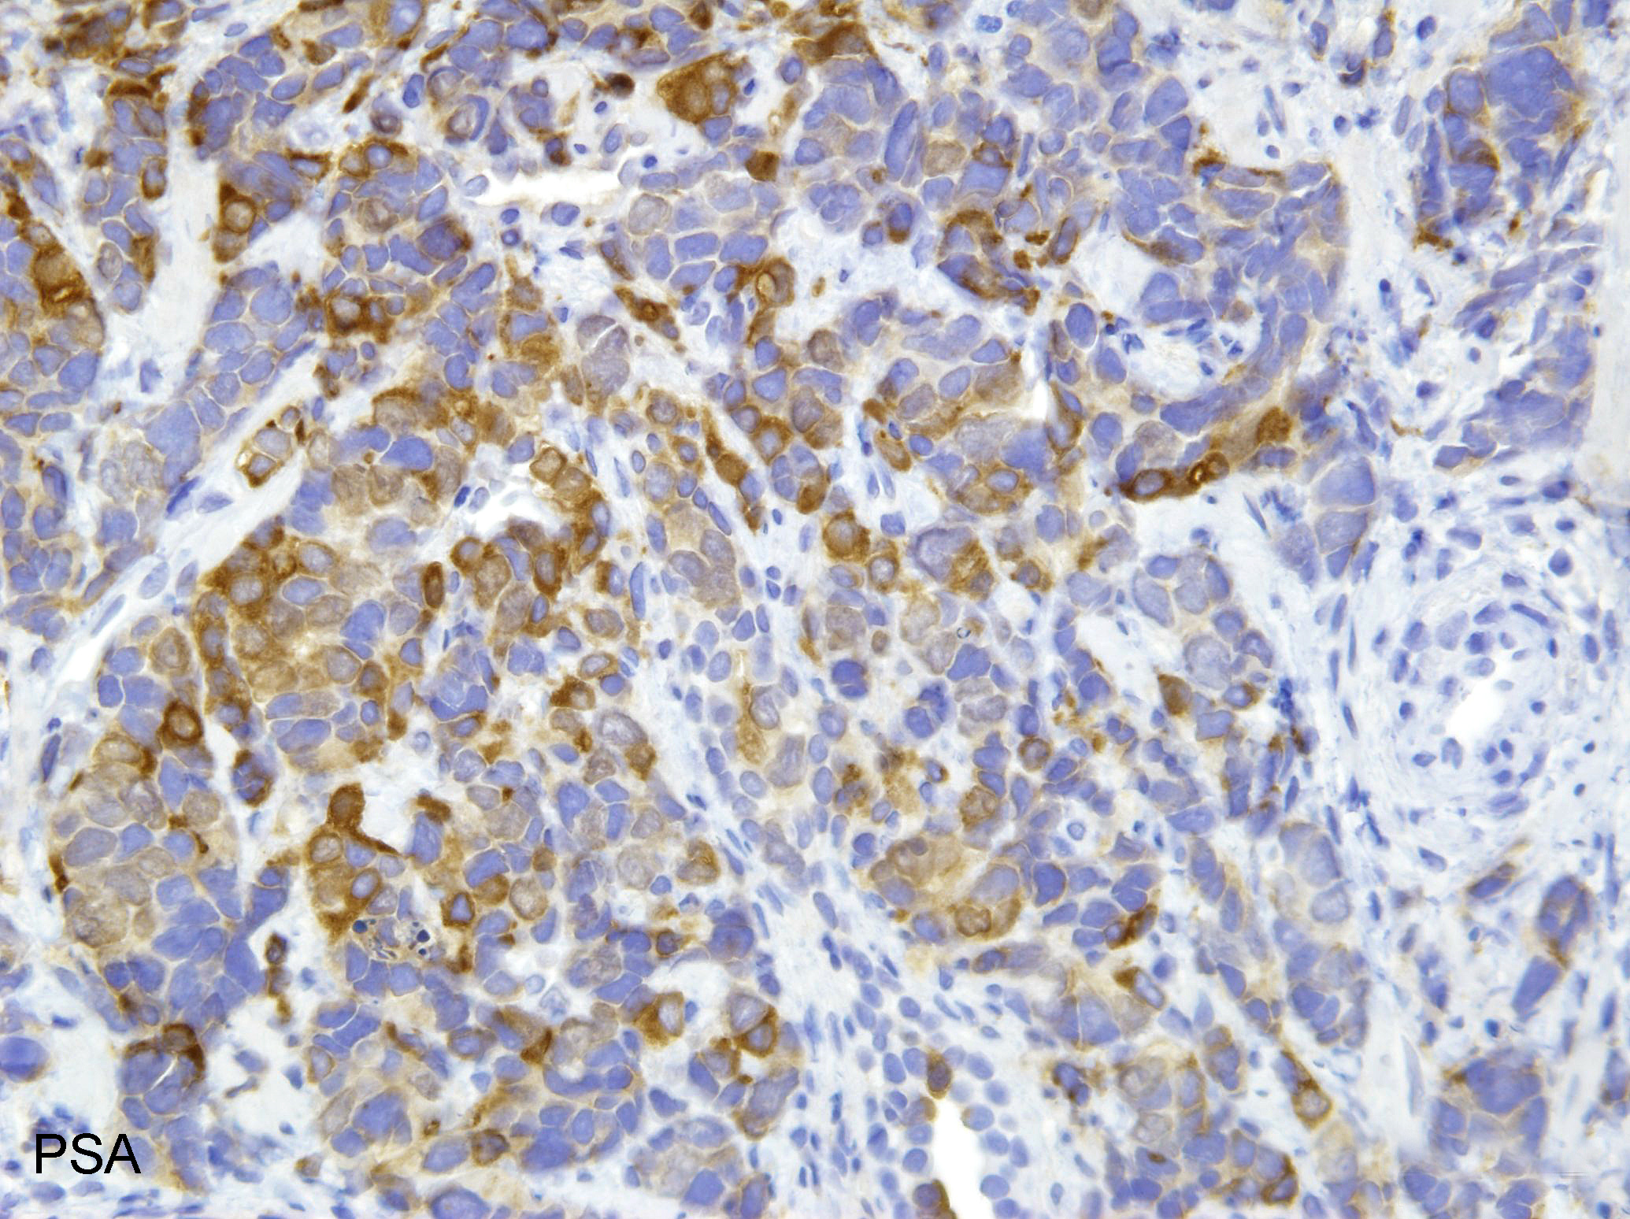

Slide 32
? Small Cell Carcinoma
Morphology – 5+5=10 (not small cell carcinoma)
PSA – diffuse +
Chromogranin – diffuse +
Synaptophysin – diffuse +
Ki67 – Markedly increased

Slide 33
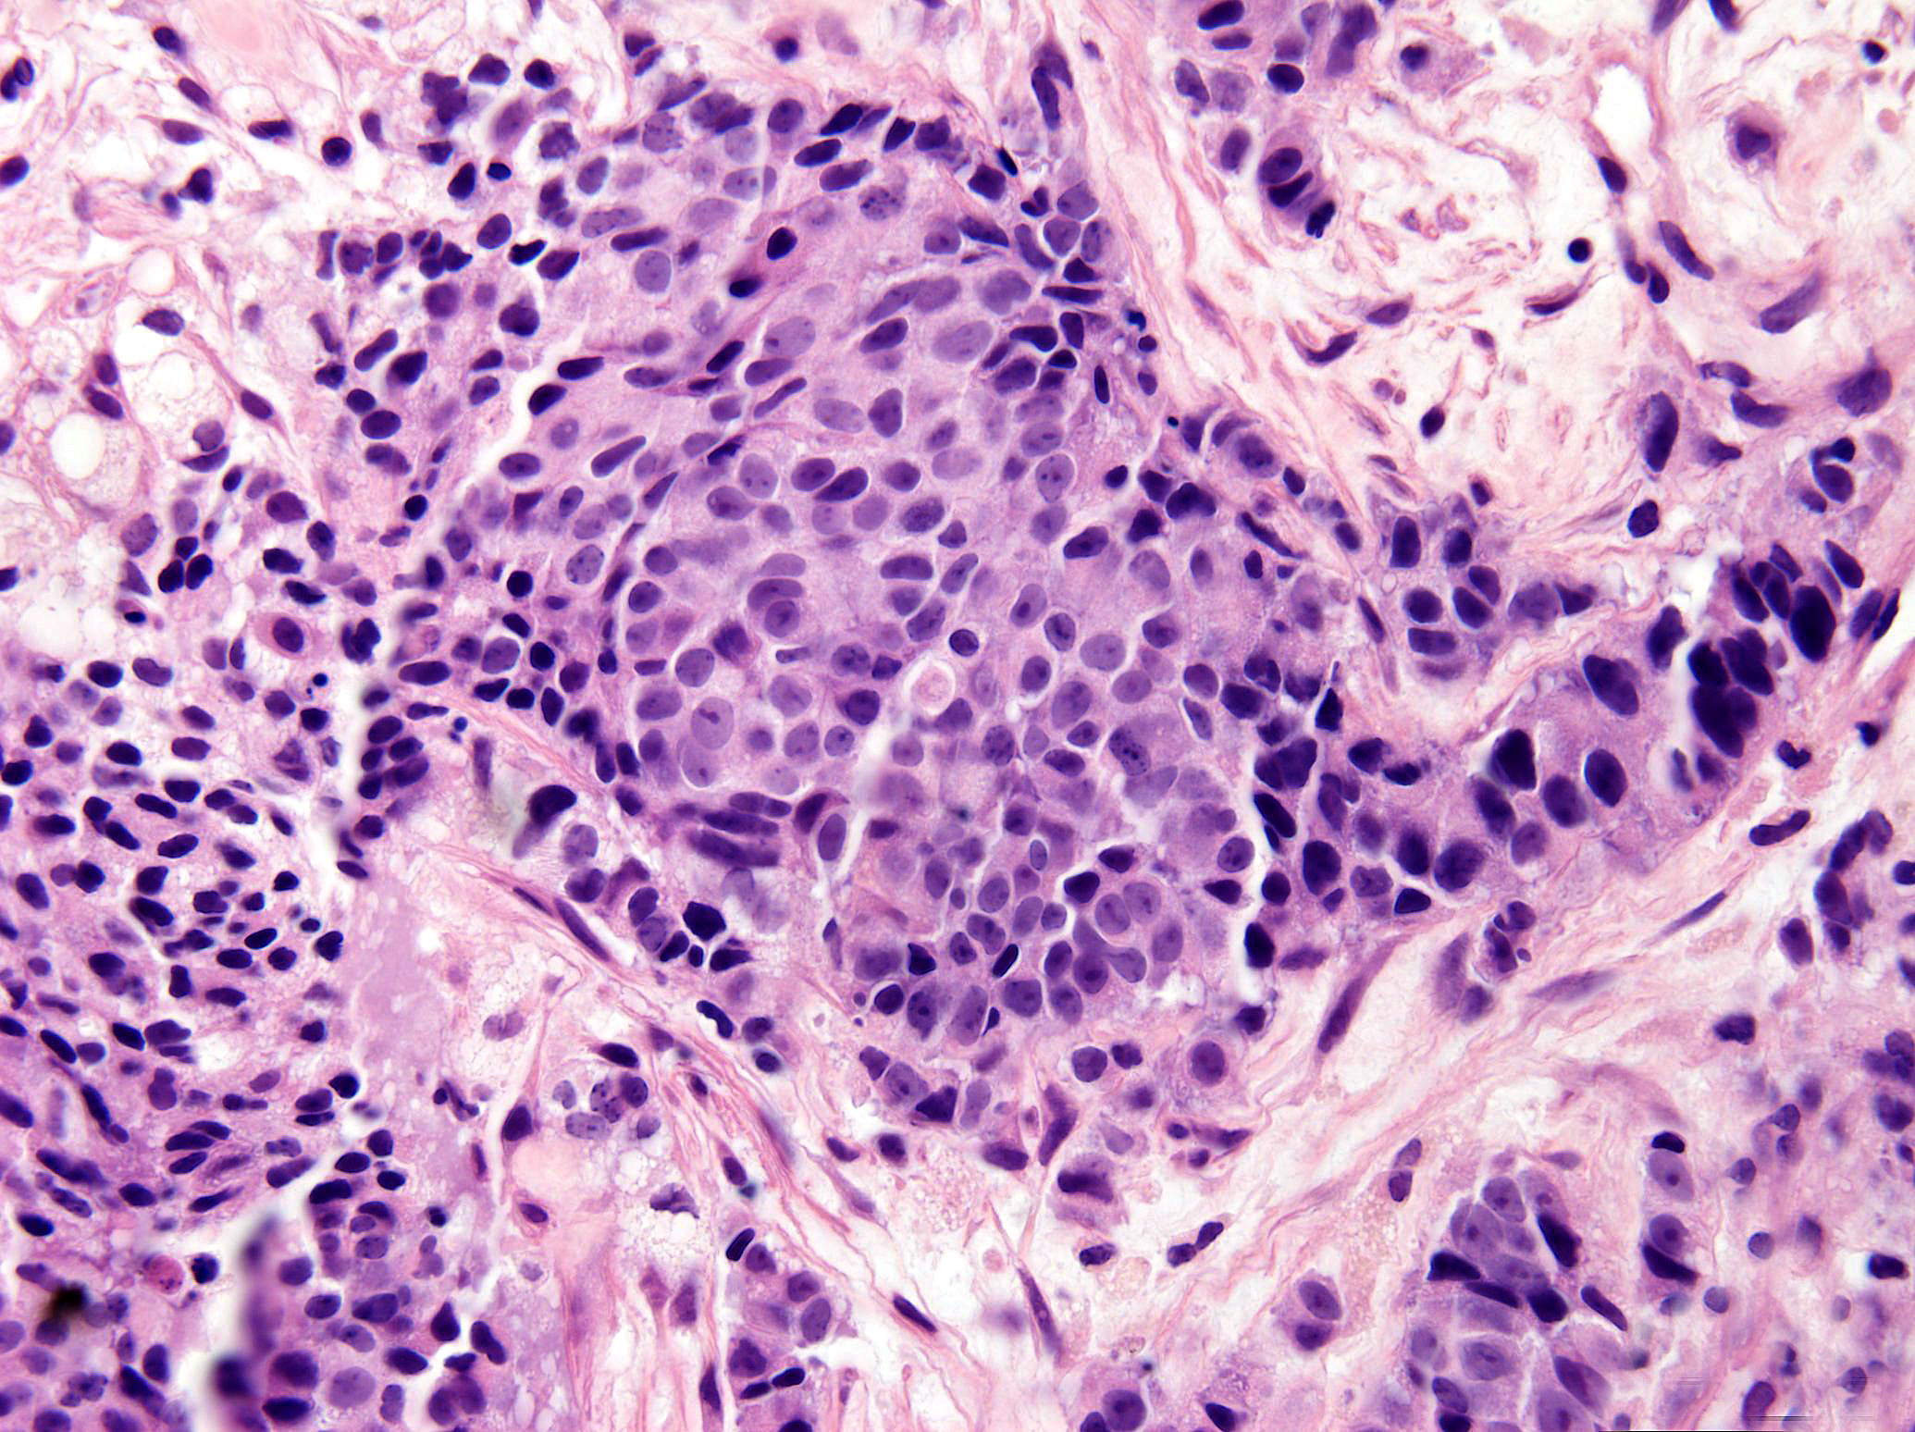

Slide 34
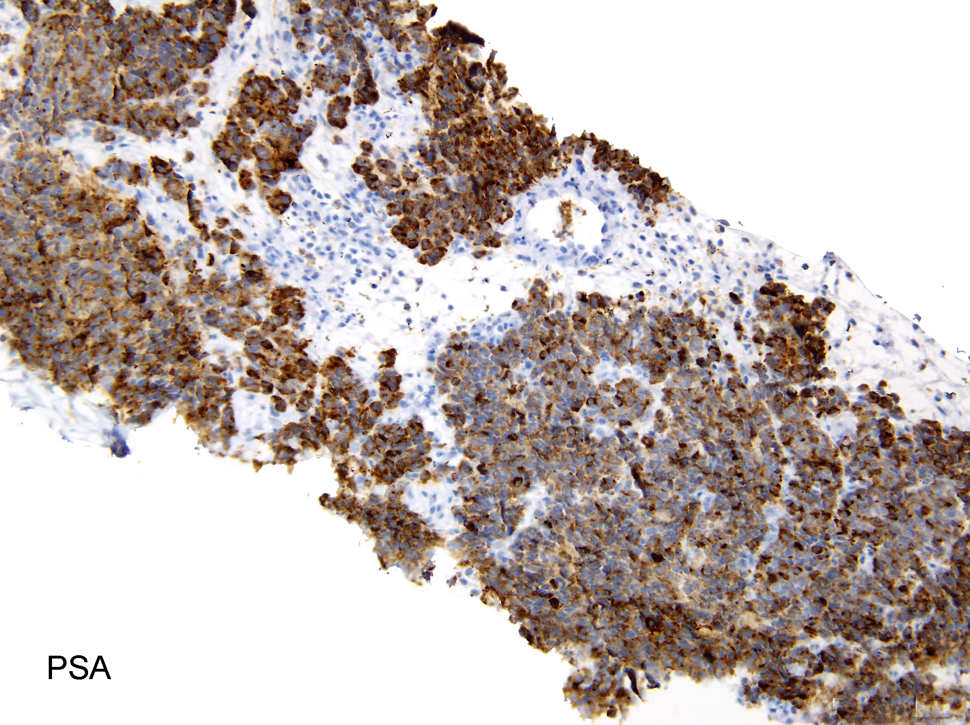

Slide 35
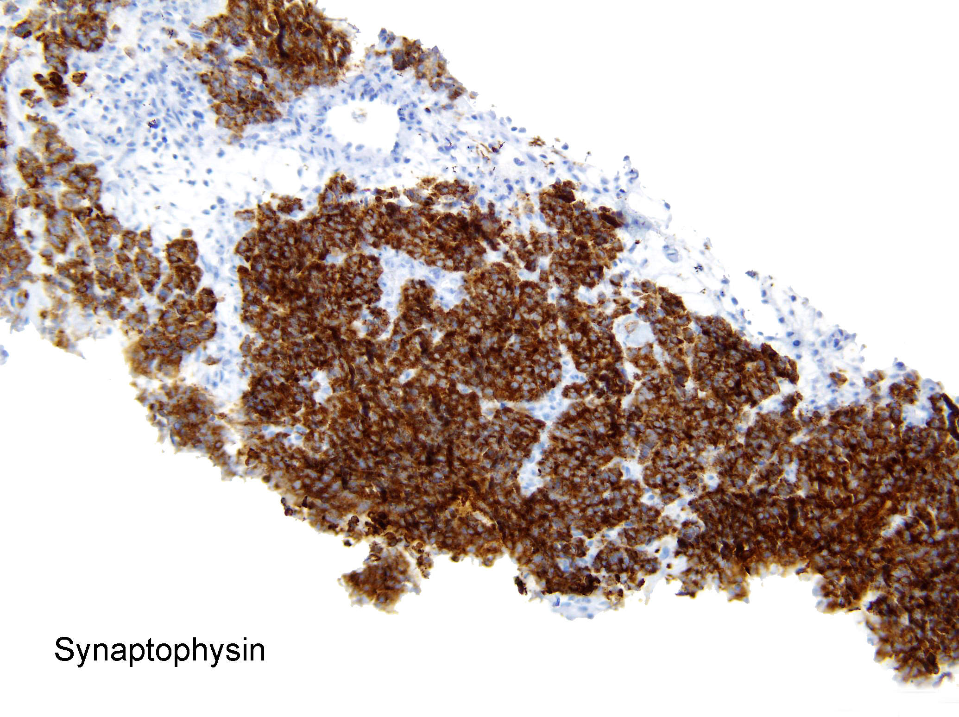

Slide 36
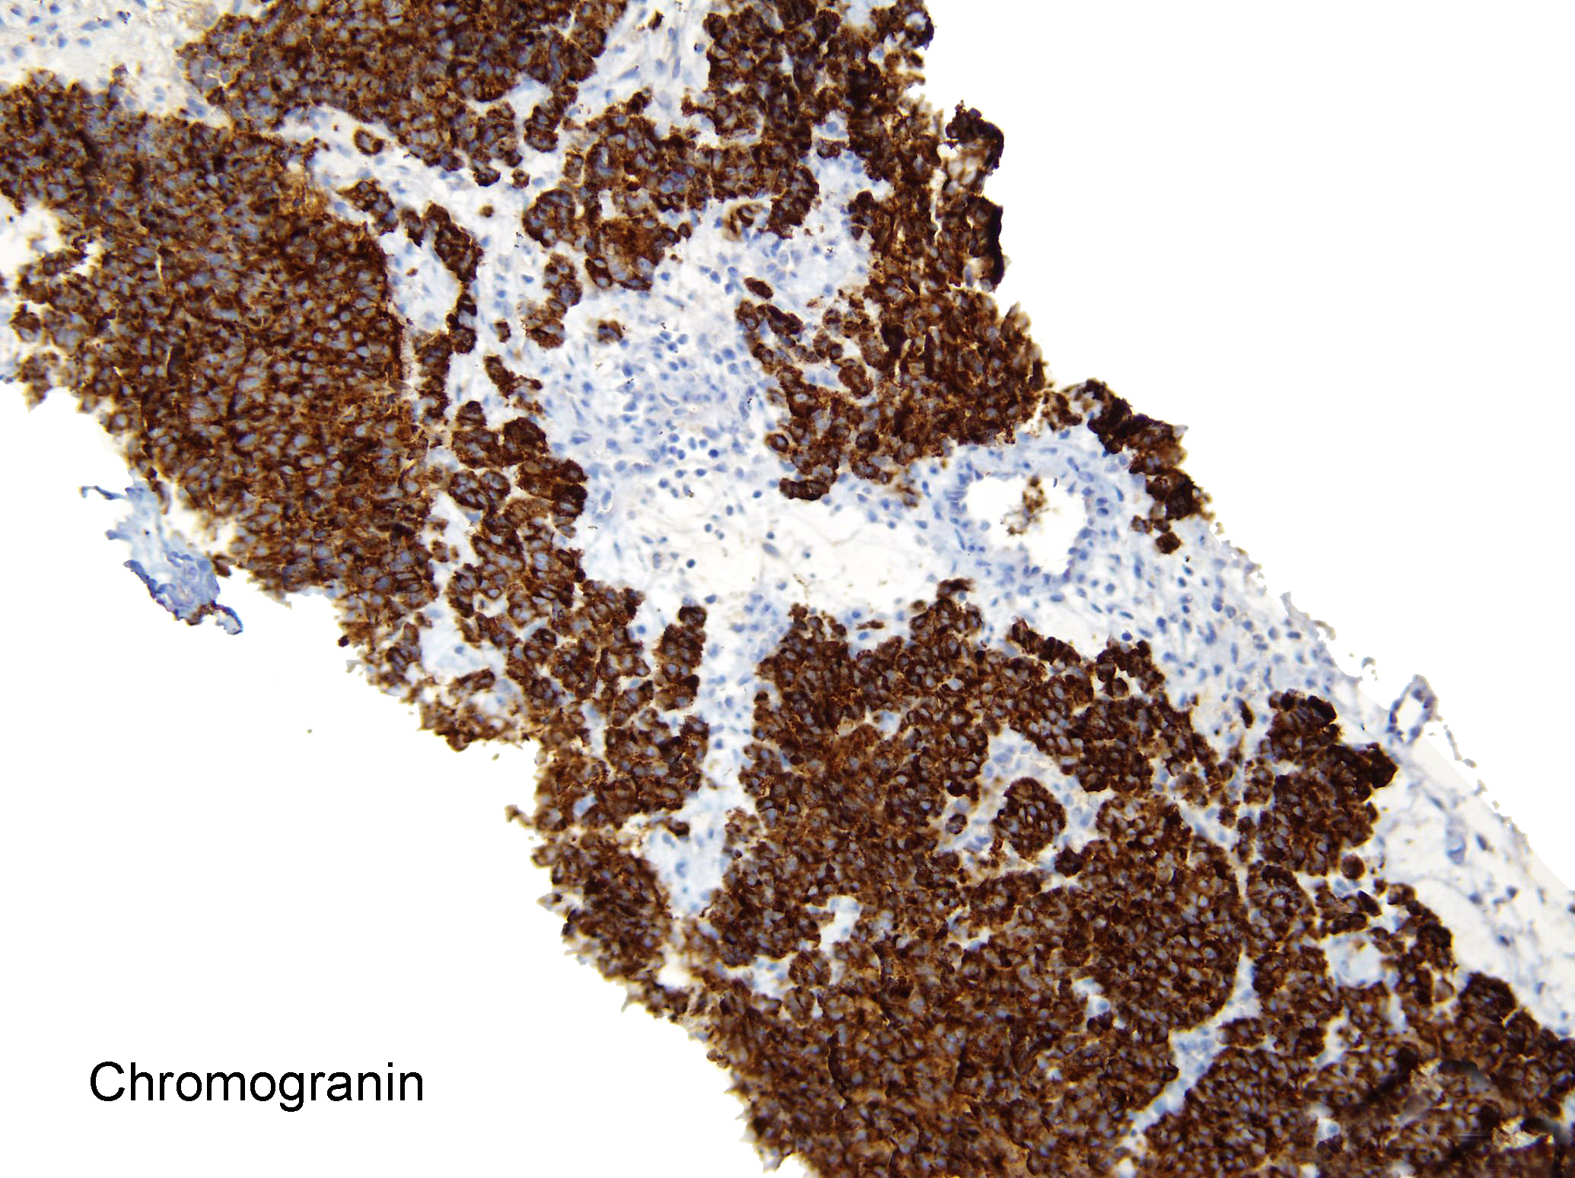

Slide 37
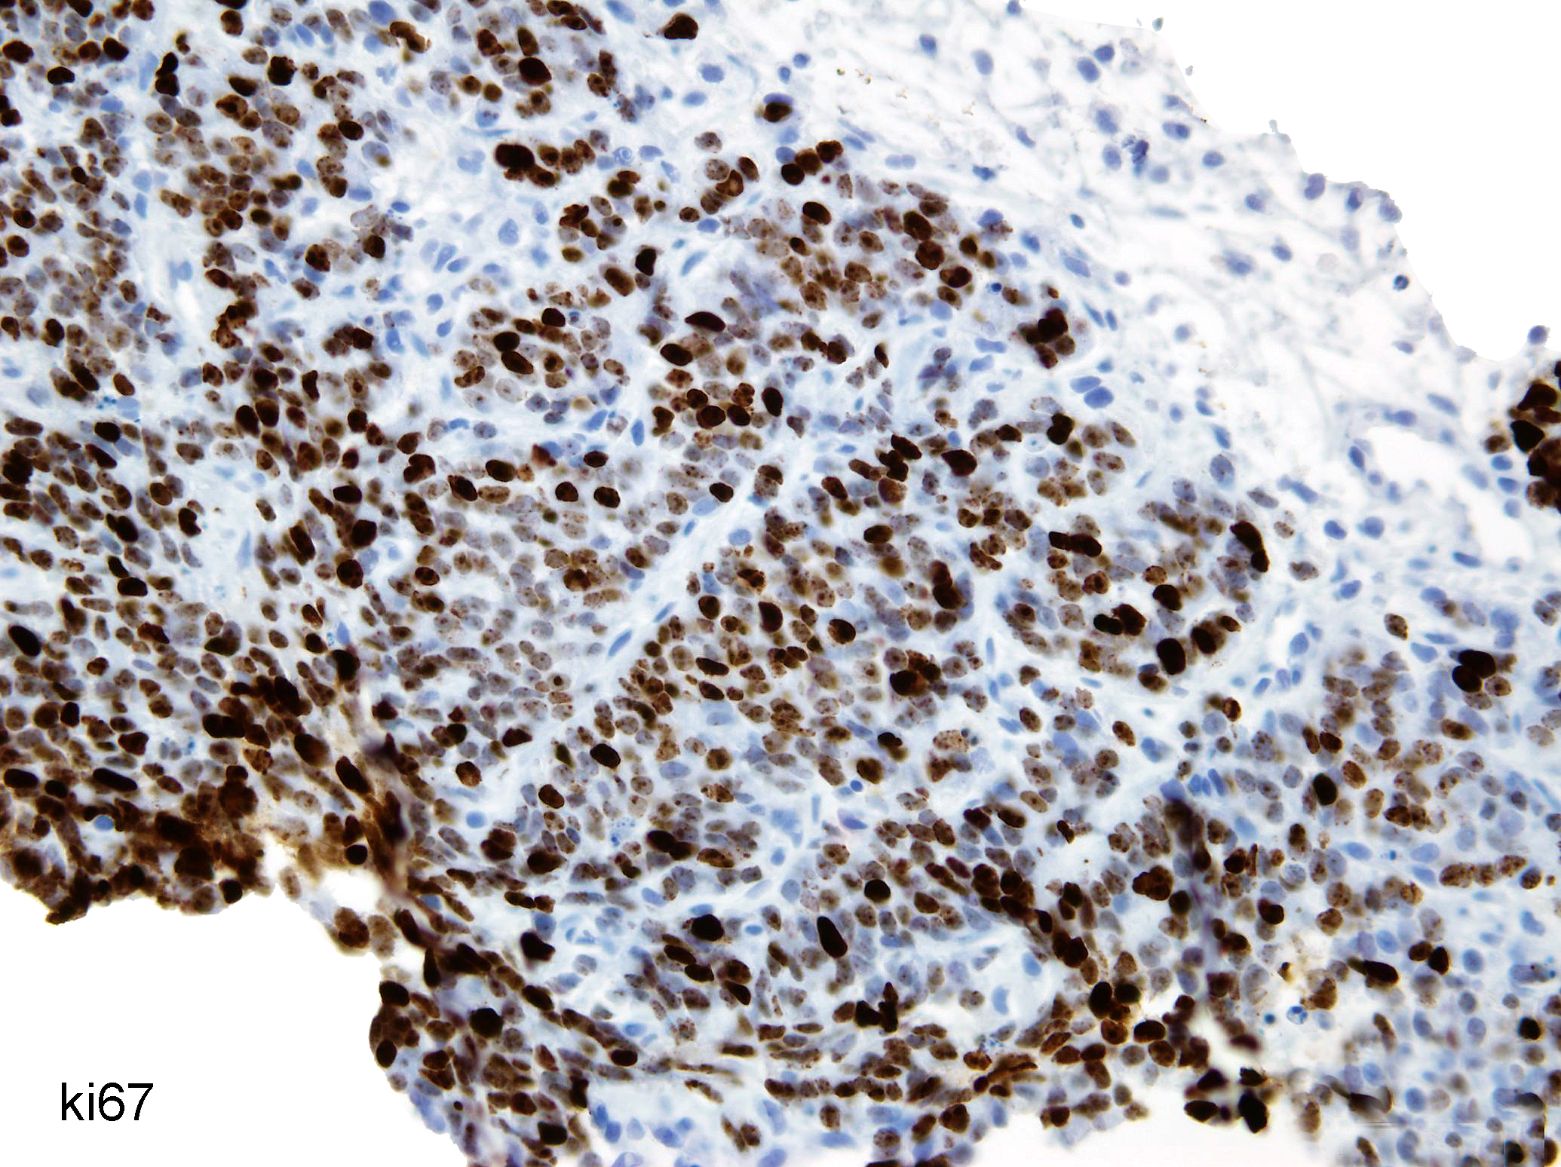

Slide 38
Example of a Diagnosis on an Overlap Case
Morphology in between usual prostate adenocarcinoma and small cell carcinoma.
Diffuse NKX3.1 positivity
Diffuse synaptophysin staining
Loss of Rb
Ki67 of over 70%

Slide 39
Comment on the Case
NOTE: Diffuse NKX3.1 positivity rules out a diagnosis of small cell carcinoma. However, diffuse synaptophysin staining, along with loss of Rb with a Ki67 of over 70%, raise the possibility of this tumor showing transdifferentiation to a high-grade neuroendocrine carcinoma.
Initially, this patient should be treated for conventional adenocarcinoma of the prostate. However, if the tumor does not respond, consideration should be given to treating the patient for small cell carcinoma.

Slide 40
Misdiagnosis of Small Cell Carcinoma
Usual prostate adenocarcinoma has numerous neuroendocrine (NE) cells if stained with NE markers (synaptophysin, chromogranin) which has no prognostic or treatment ramifications.
Not uncommon for Gleason score 5+5=10 to be misdiagnosed as small cell carcinoma if stains for NE markers are done.

Slide 41
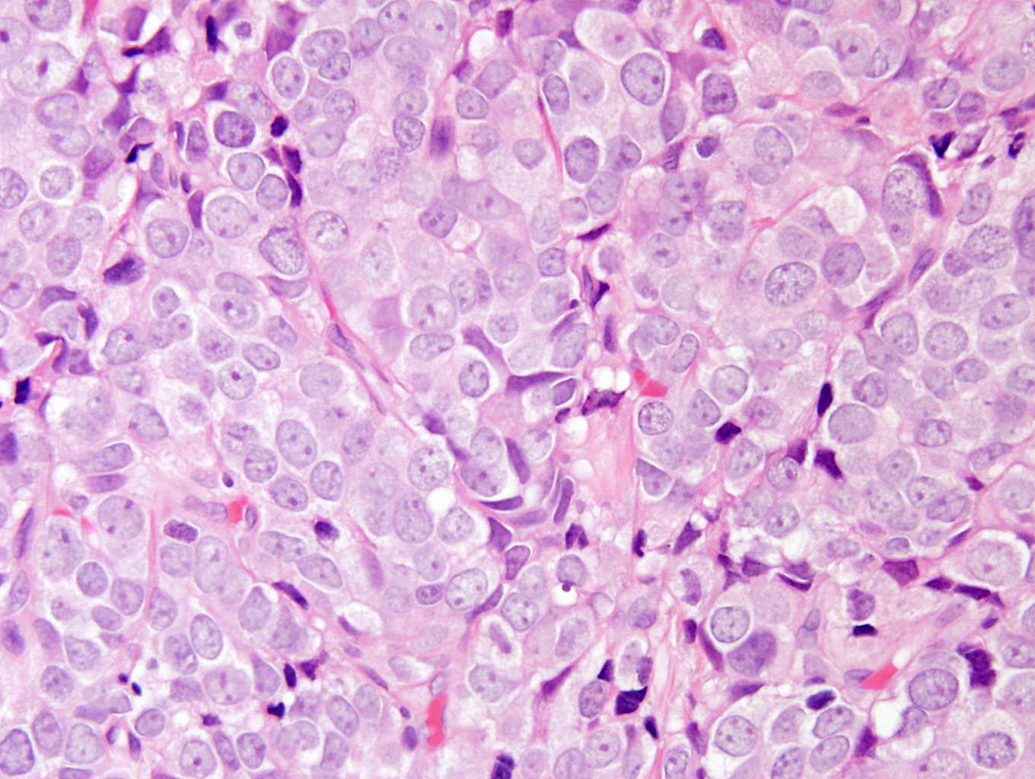

Slide 42
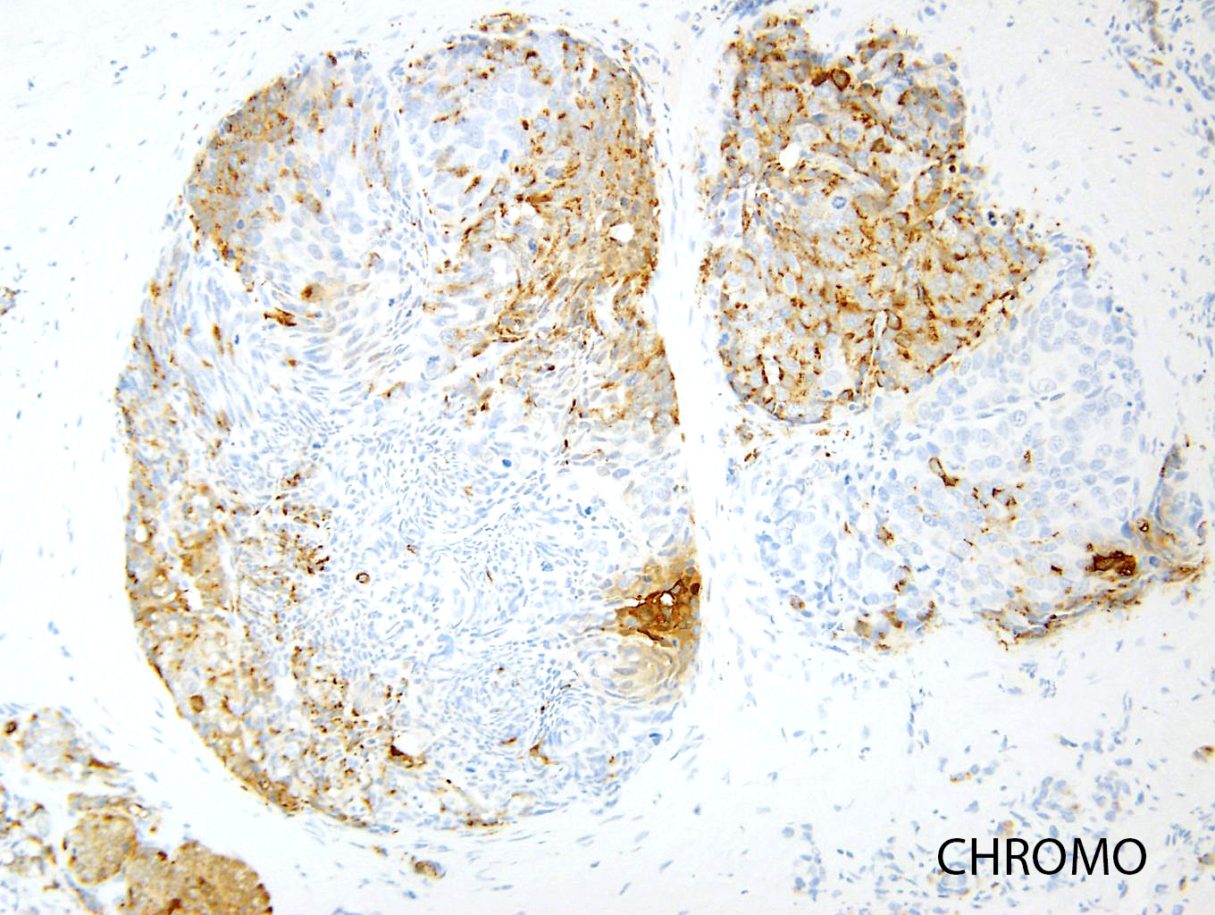

Slide 43
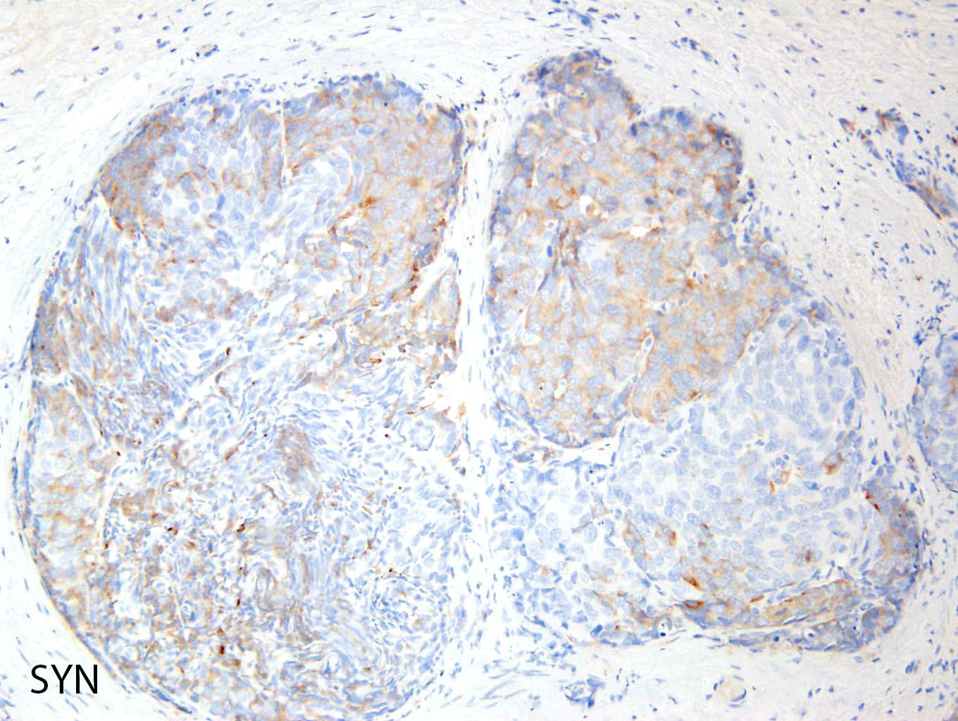

Slide 44
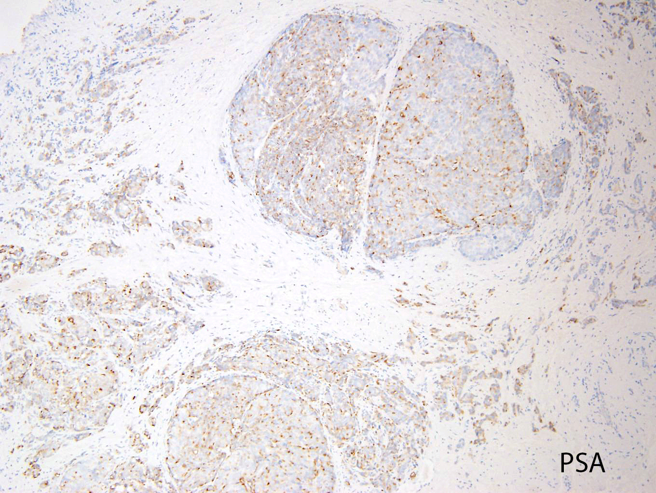

Slide 45
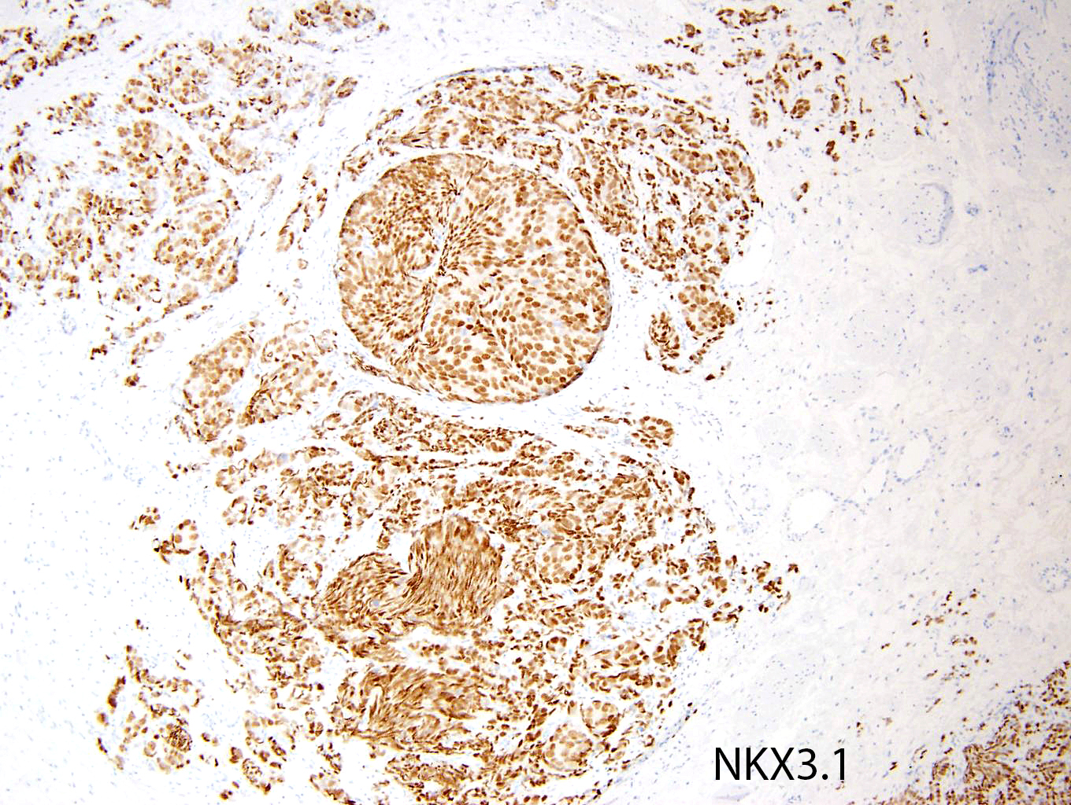

Slide 46
NOTE: There is no evidence of small cell carcinoma based on the tumor's morphology. The presence of neuroendocrine differentiation on the immunohistochemical stains provided is not specific and can be seen in usual prostate adenocarcinoma without any prognostic significance.

Slide 47
Misdiagnosis of Small Cell Carcinoma:
Adult Rhabdomyosarcoma
Rare rhabdomyosarcomas seen in adults.
May have overlap with small cell carcinoma.
Synaptophysin positivity can be misleading so important to rule out muscle tumor with desmin and myogenin.

Slide 48
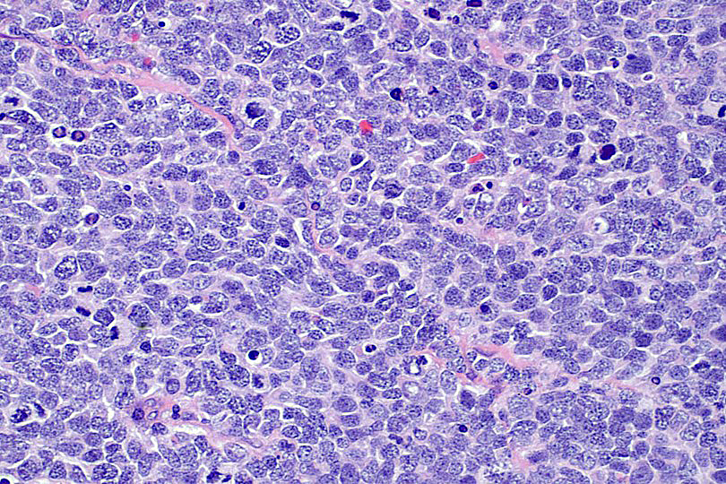

Slide 49
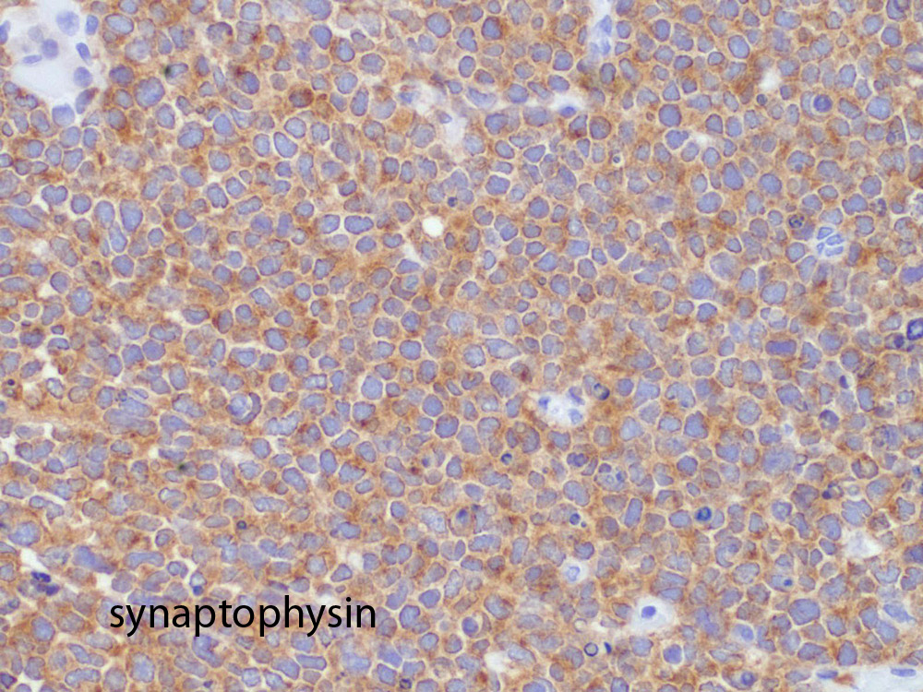

Slide 50
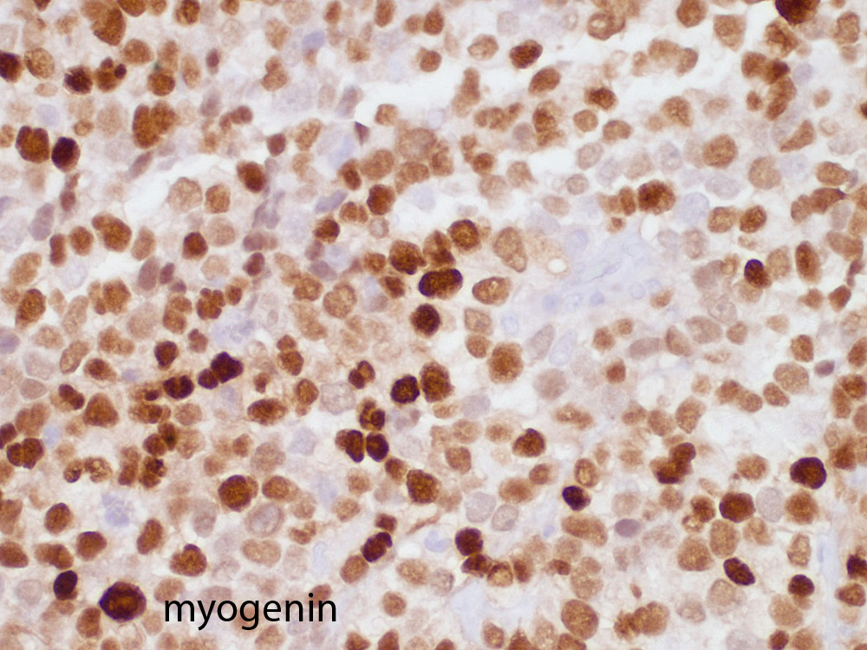

Slide 51
Large Cell Neuroendocrine Carcinoma
Sheets of cells with large nuclei with prominent nucleoli
Most cases admixed with usual prostate adenocarcinoma
Strong staining for NE markers
Focal prostate markers
Ki67 >50%
Loss AR
All dead of disease with widespread mets. (mean survival 7 months)

Slide 52
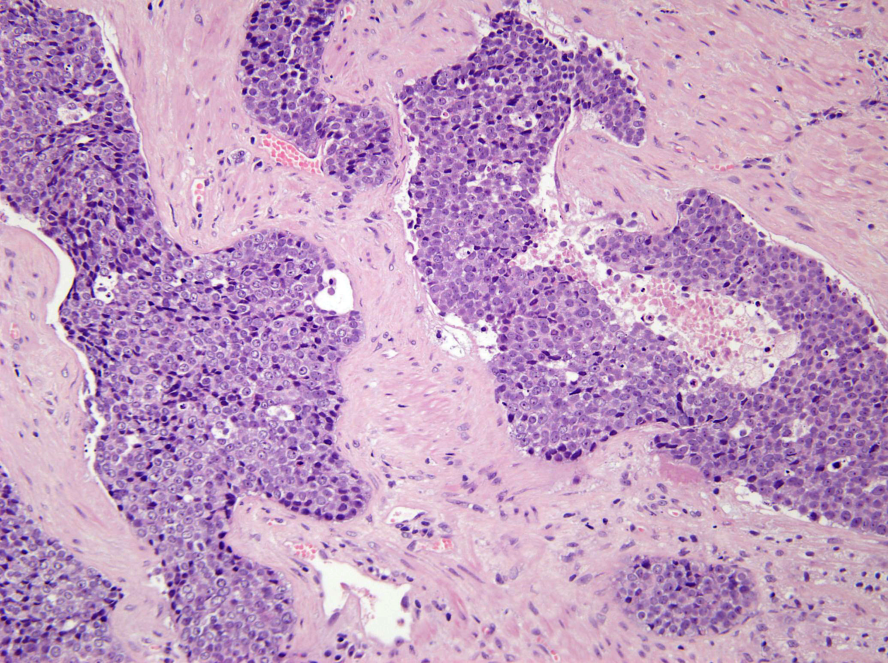

Slide 53
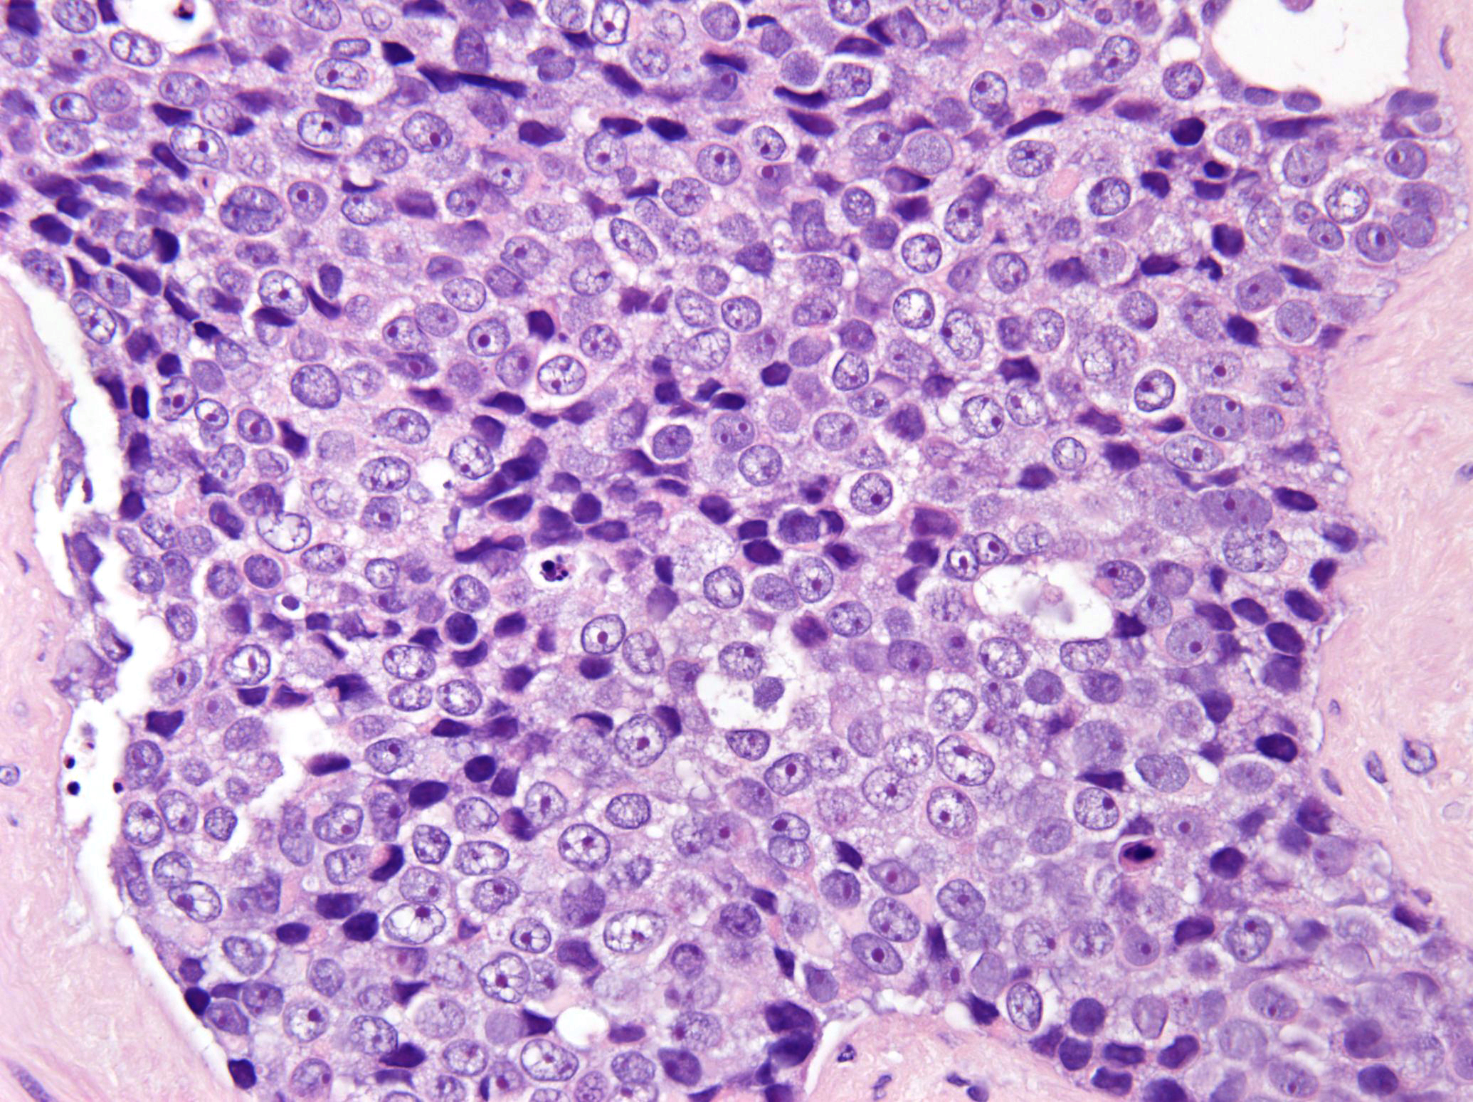

Slide 54
IHC
Synaptophysin – diffuse +
Chromogranin – diffuse +
Negative or at most focal prostate-specific markers

Slide 55
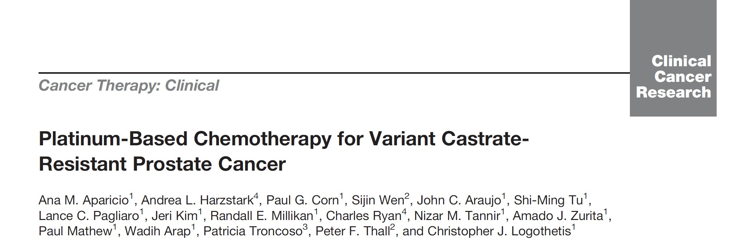
? Small Cell Carcinoma Defined Clinically
19: 3621-30, 2013

Slide 56
Clinical Small Cell Carcinoma
(1 of the Following Criteria)
Exclusively visceral metastases.
Radiographically predominant lytic bone metastases.
Bulky (5 cm) lymphadenopathy in prostate/pelvis.
Low PSA (<10 ng/mL) at initial presentation (before ADT or at symptomatic progression in the castrate setting) plus high volume (>20) bone metastases.

Slide 57
Clinical Small Cell Carcinoma
Presence of NE markers on histology (positive staining chromogranin A or synaptophysin) or in serum (abnormal high serum levels for chromogranin A) at initial diagnosis or at progression. Plus any of the following: A. elevated serum LDH (>2 IULN); B. malignant hypercalcemia; C. elevated serum CEA (>2 IULN).
Short interval (<6 months) to androgen-independent progression following the initiation of hormonal therapy
Recommends treat like small cell carcinoma

Slide 58
Paneth Cell-Like Neuroendocrine Differentiation in Prostate Cancer

Slide 59
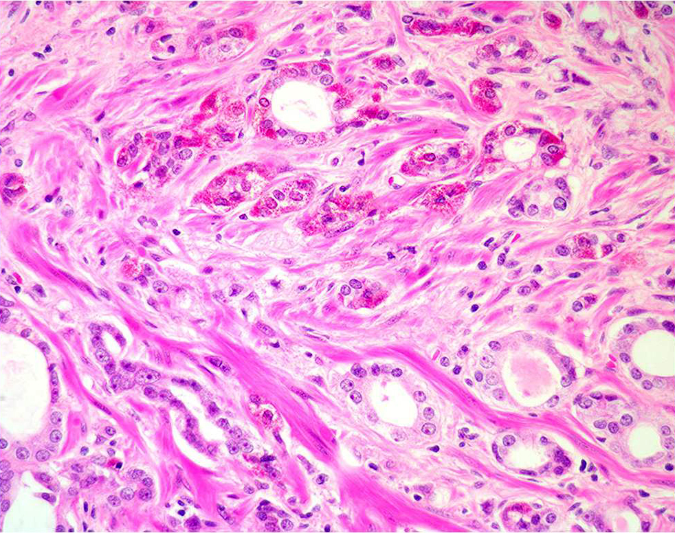

Slide 60
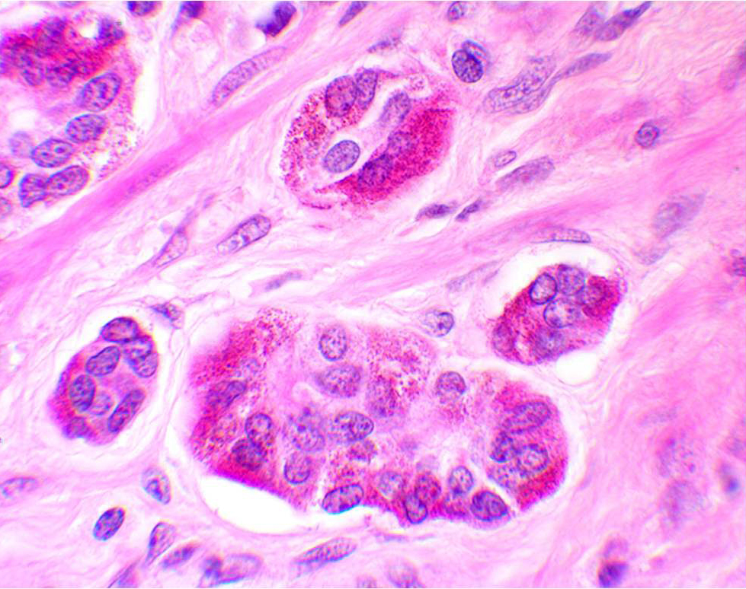

Slide 61
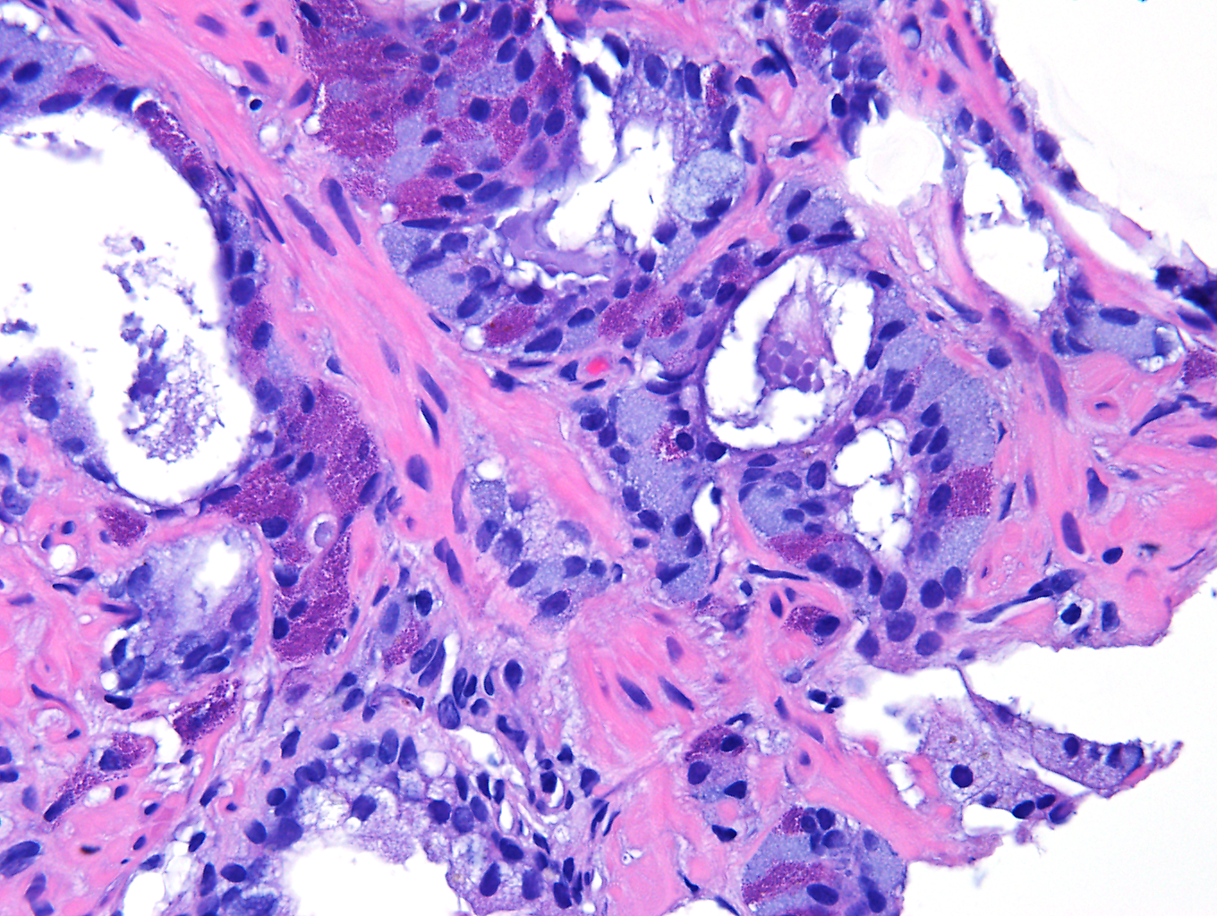

Slide 62
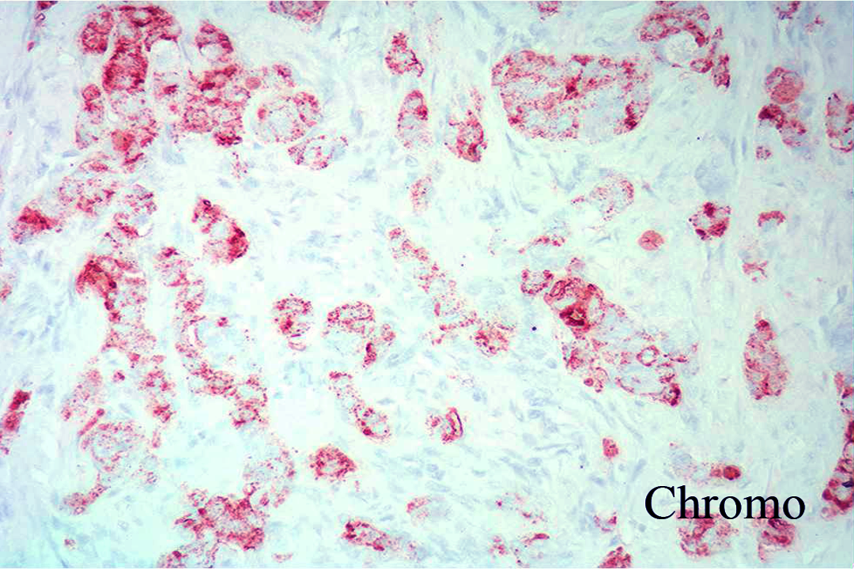

Slide 63
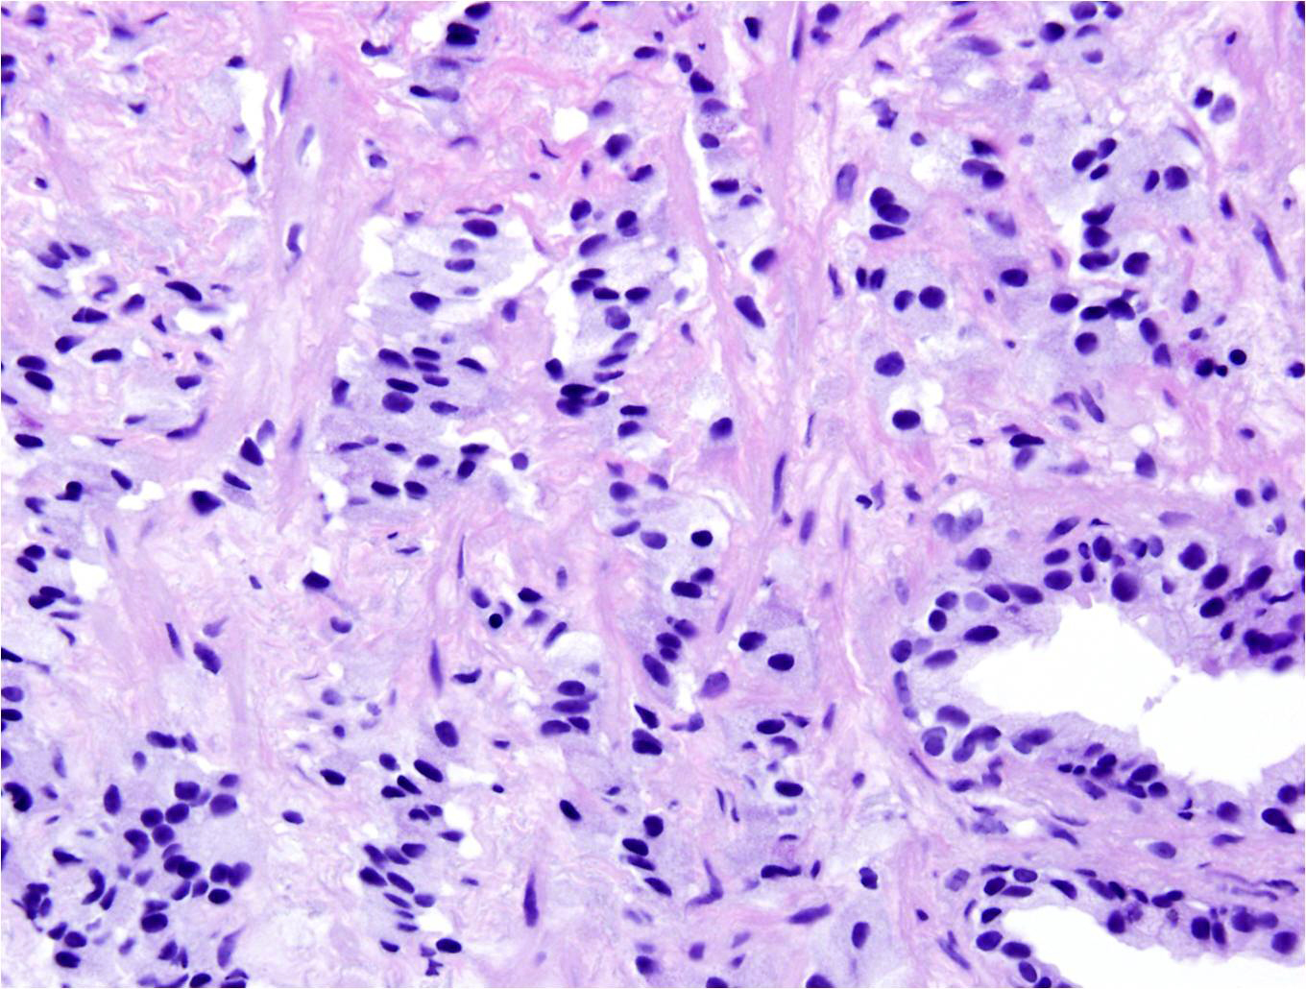

Slide 64
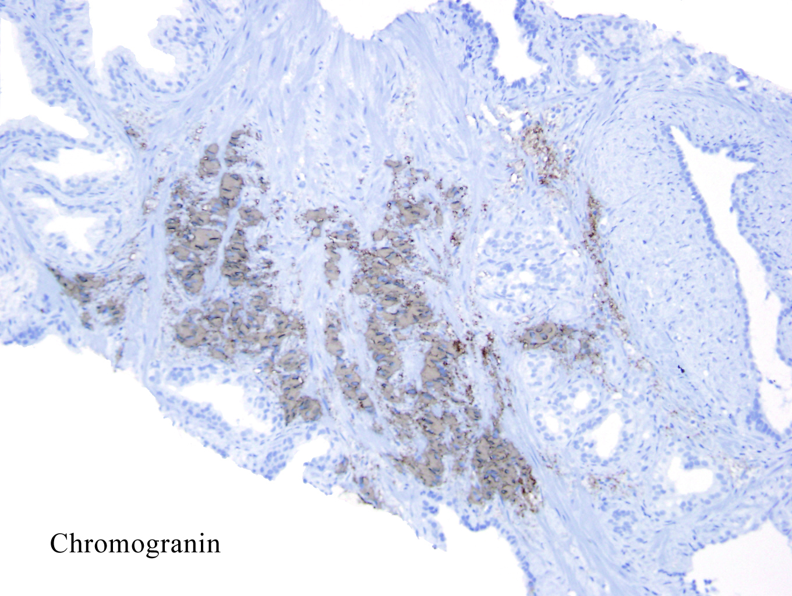

Slide 65
Prognosis – Paneth Cell-Like Neuroendocrine Differentiation
Prostate cancer with Paneth cell-like neuroendocrine differentiation behaves like Gleason score 3+3=6. Do not grade solid nests or cords of cells with Paneth cell-like neuroendocrine differentiation as 5+5=10.
If report “Prostate cancer with Paneth cell-like neuroendocrine differentiation” clearly state not small cell carcinoma.

Slide 66
Well-Differentiated NE Tumor (WDNET)
[Carcinoid Tumor]
Only a few cases of true WDNETs of the prostate – range in prognosis from incidental to metastatic
With rare exceptions, tumors that resemble WDNET in the prostate are ordinary adenocarcinomas of the prostate with bland cytology (PSA+, Chromogranin+) admixed with usual adenocarcinoma.

Slide 67
Summary
There exists a wide range of NE differentiation in the prostate, some with no clinical significance and others which have a major impact on prognosis and treatment.
In the prostate, more than other organs, the diagnosis of small cell carcinoma in some cases can be more challenging due to overlap cases.

